Slide 1
Australia’s #WTF Economy… …and How to Fix It
Jim Stanford
Economist & Director, Centre for Future Work
#Uniontown Conference, October 2019

Slide 2
www.futurework.org.au
@jimbostanford
@cntrfuturework

Slide 3
#WTF: Puzzling Economic Trends…

Slide 4
Labour Producing More

Slide 5
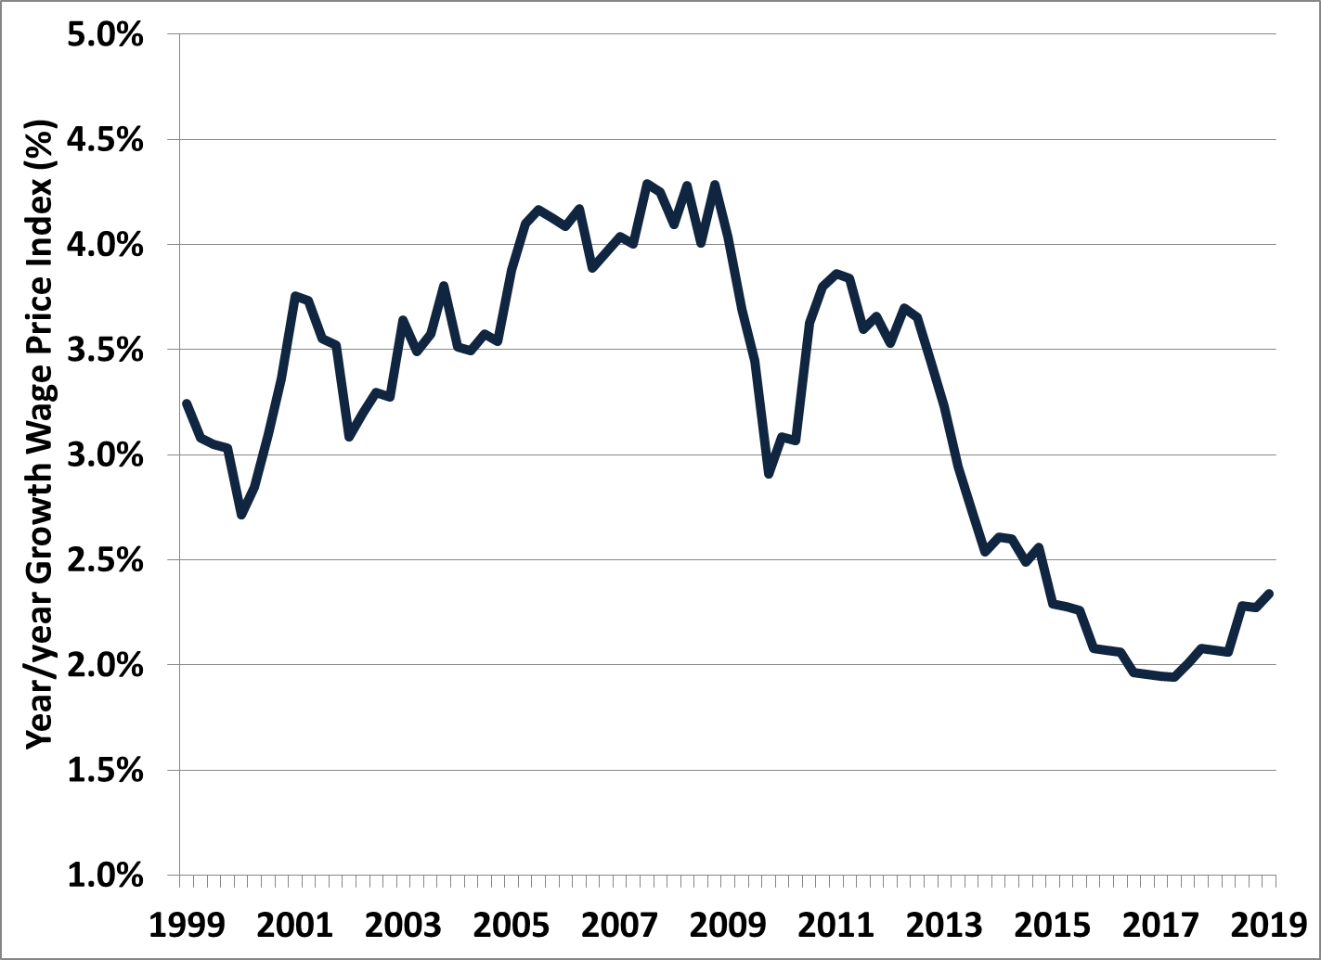
Labour Getting Paid Less
Sustained deceleration after 2013

Slide 6
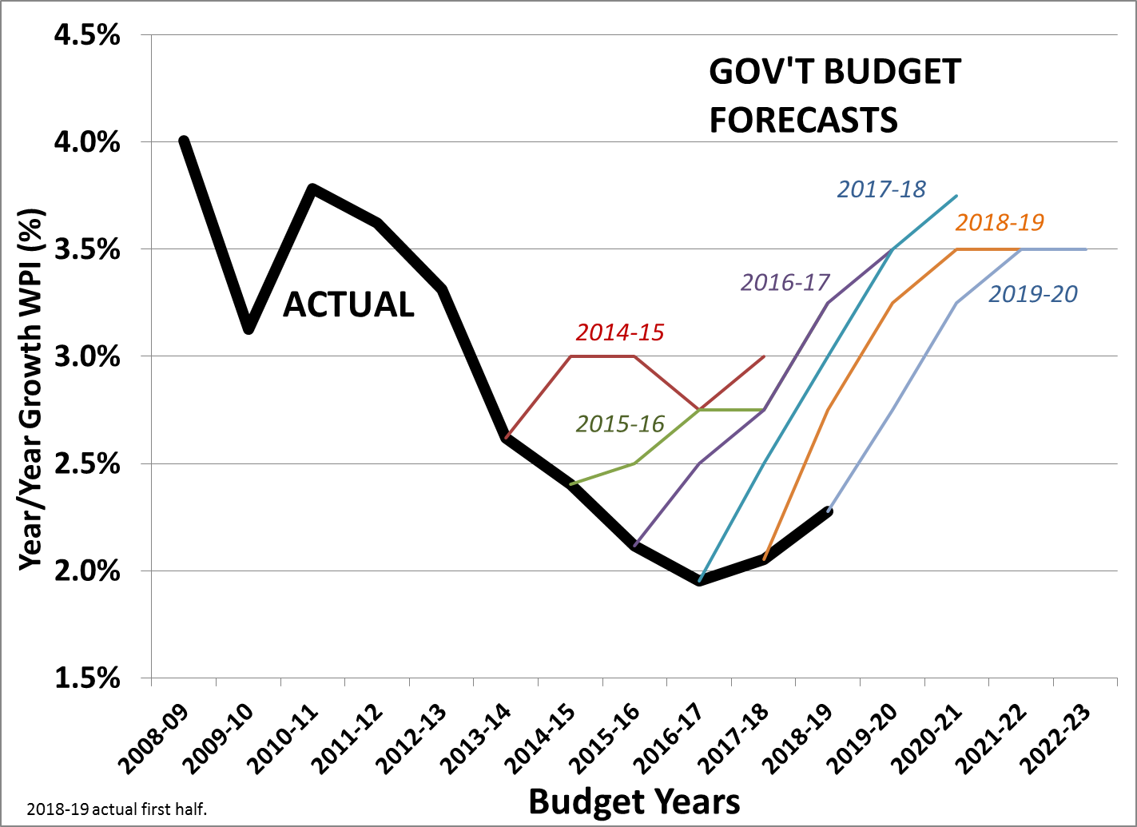
Still Hoping…

Slide 8
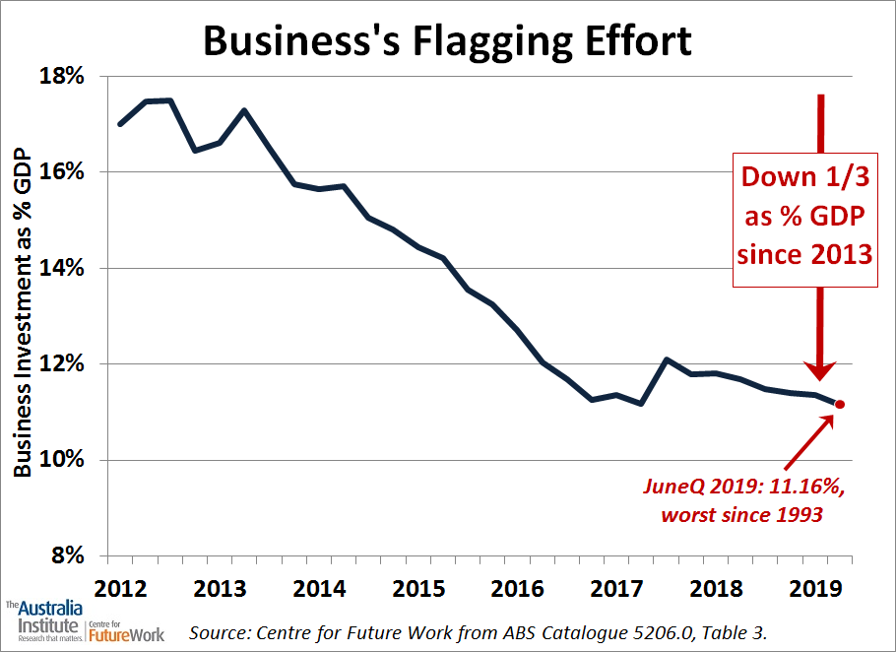

Slide 9
Business Gets Paid More

Slide 10
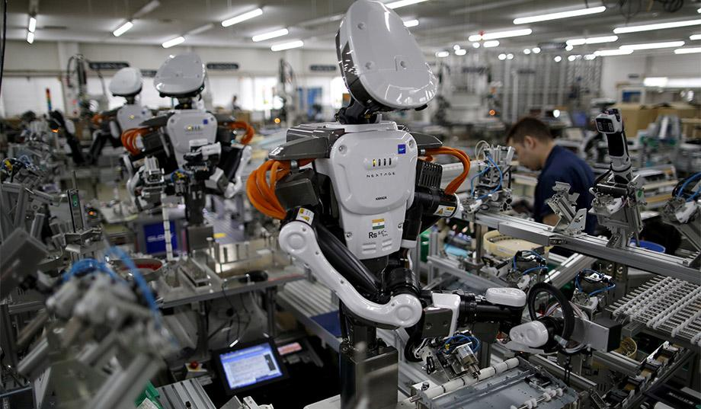
Technology Advances...

Slide 11
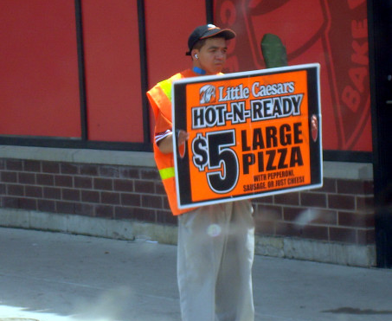
Technology Advances...
…But Jobs Are Degraded

Slide 12
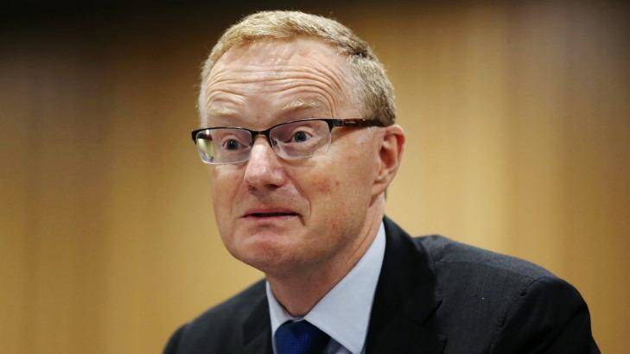
Central Banker calls for Worker Uprising
“Some pick-up in wages would be a welcome development.”

Slide 13
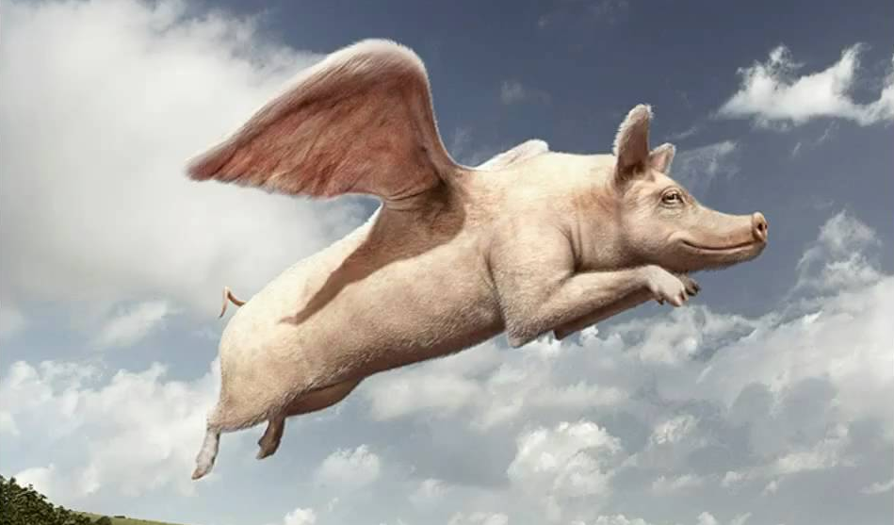
Central Banker calls for Worker Uprising

Slide 16
Diagnosis
Labour market underperforming on both quantity and quality grounds.
Employers taking advantage of that weakness (and resulting desperation) to intensify exploitation.
Government is facilitating and endorsing this trend, rather than protecting workers.
Trickle-down economics is not growing the pie:
It’s redistributing it (upward).

Slide 17
The Quantity Problem
“Official” unemployment: 700,000+.
Underemployment: 1.1 million+.
Lost participation: 400,000+.
“Marginally attached”: 1 million?
TOTAL SLACK: 3 million (15% of adjusted labour force).

Slide 18
The Quality Problem: Precarity
Employers prefer a “just in time” work force:
Available when and where they need it.
“Off the books” otherwise.
Many forms of precarity:
Irregular part-time work.
Temporary / contract jobs.
Independent contractor.
Marginal self-employment.
Now over half of Australian workers experience at least one of these dimensions of precarity.

Slide 19
The Regional Economic Crisis
Governments have abandoned regional development strategy.
Public sector anchors for regional economies have been downsized.
Regions are held hostage to private investment, which is inadequate and driven only by profits.
Concentrated in capital cities.
Creates desperation for any kind of work.
Exploited by extractivist mentality.

Slide 20
A Little Economics Lesson
The gifts of nature, and our capacity to work, are the ultimate constraints on our economic potential.
The purpose of our work is to meet human needs (survive & thrive) including a sustainable environment.
Notes:
Most dangerous myth.

Slide 21
We Need An Engine That Fires on All Cylinders

Slide 22
We Need An Engine That Fires on All Cylinders
Macroeconomic dimension:
Boost wages, boost purchasing power.
Put job-creation ahead of “surplus.”
Sectoral dimension:
Boost strategic industries (through industrial, innovation, and trade interventions).
Public sector dimension:
New demand and jobs through public spending.
Regional dimension:
Direct investment (public & private) to all regions.
Labour market inclusion/planning dimension:
Skills and information.
Inclusion (racialized, women, youth, ability).

Slide 23
Ten-Point Plan for Good Jobs
Grow “anchor” industries with global potential
A real innovation strategy: more than jargon
Creating good jobs in a green economy
Creating good jobs in the public sector
Strong purchasing power to fuel strong job-creation
Equipping Australian workers to do the job
Helping Australian companies lift their game
Improving job quality in all sectors
Ensuring fair access to good jobs for all communities and all regions.
Facilitating mobility and opportunity

Slide 24
The Good News
Our capacity to work is better than ever.
More of us; better skills; higher productivity.
There is no shortage of “money.”
Billions created every day
Protecting the environment will create huge numbers of jobs.
Our problem is political, not economic.
Build power so that our interests prevail, not business’s.

Slide 25
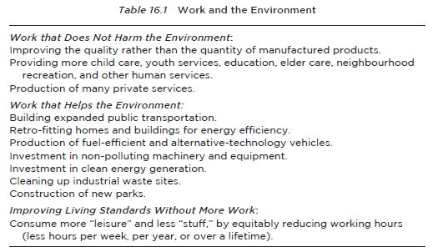
Transitions are much easier in an economy where everyone has access to work.

Slide 26
Declare “War,” End Stagnation
1939: 10-year depression ended immediately.
World faced enormous shared challenge.
Side-stepped profit motive for initiating work and production.
Put everyone to work, overnight.
Living standards (on home front) improved!
Shortage of “money” was never a problem.
So let’s do it again!
Declare war on pollution, poverty.
Put people to work, generate income, pay taxes.
Notes:
Life expectancy grew.

Slide 27
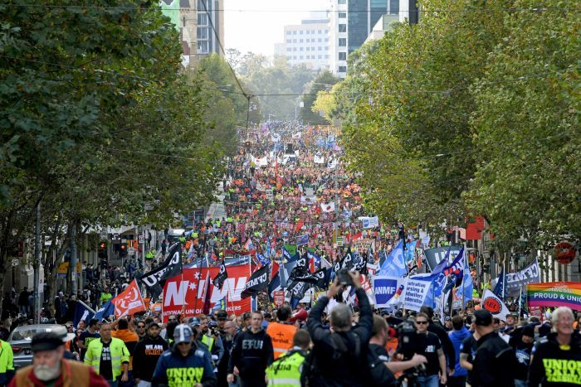
How Change Will Happen
Build popular consciousness about what is real, what is fair, and what is possible.
Build a new economic “common sense.”
Then organize to win that vision.

Slide 28
Thank You!
www.futurework.org.au
@jimbostanford
@cntrfuturework

