Slide 1
www.youngworkerscbr.org.au
Notes:
YWC – a quick couple of points

Slide 2
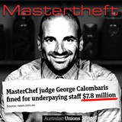
In our 2018 survey, 52% of workers reported having their wages stolen in the previous 12 months.
Notes:
What’s the problem? Anger

Slide 3
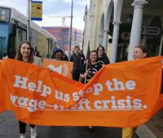
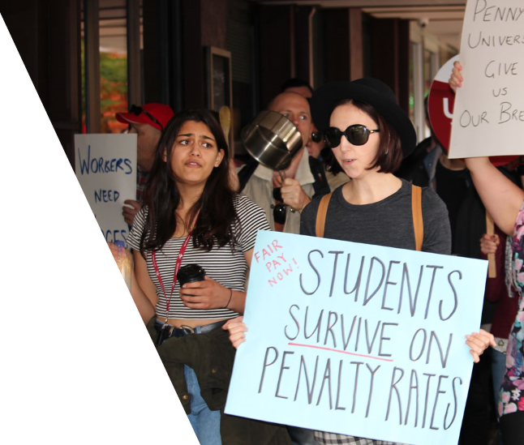
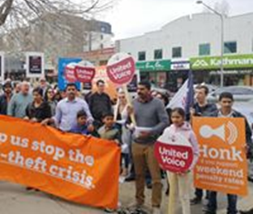
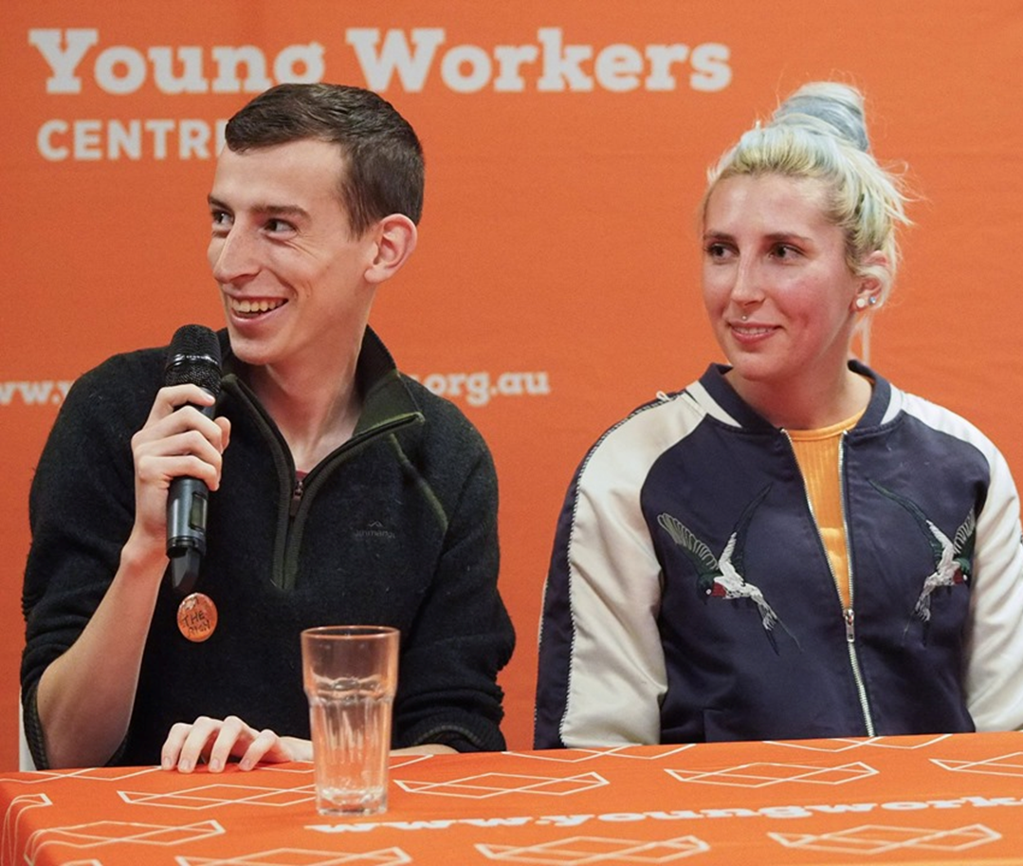
Notes:
What are we going to do about it? Organise, campaign, skills development for young activists, a voice for young workers and education about rights. Hope.

Slide 4
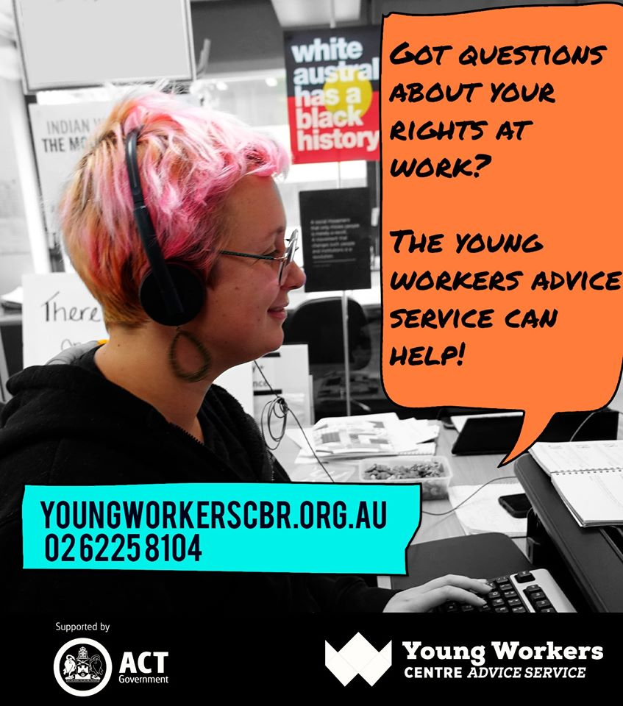
Notes:
Advice, information - basics

Slide 5
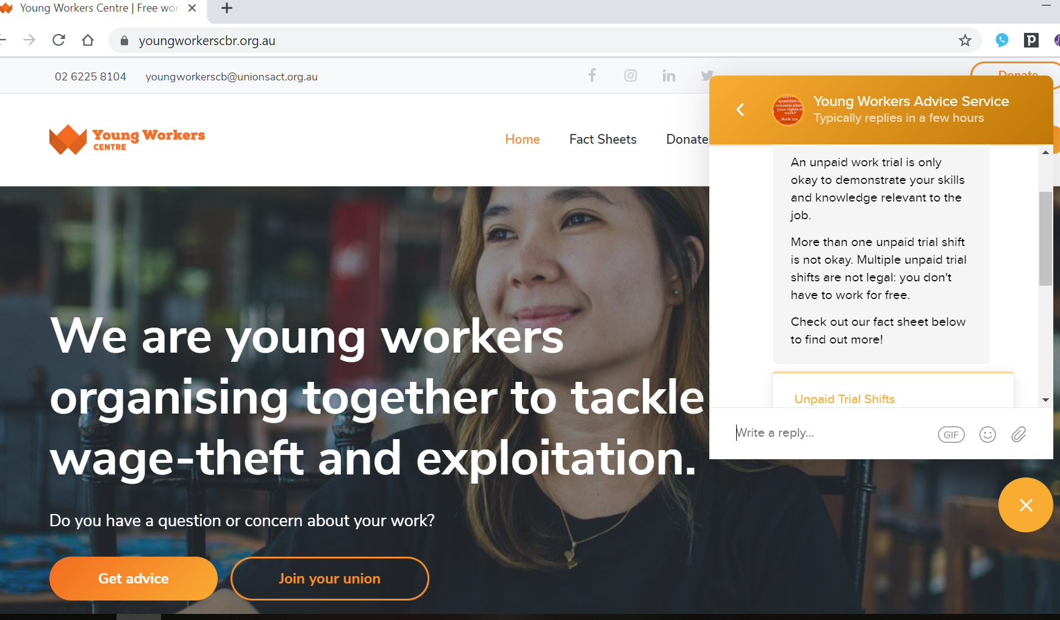
Notes:
Advice Service – what it is, how it works

Slide 6
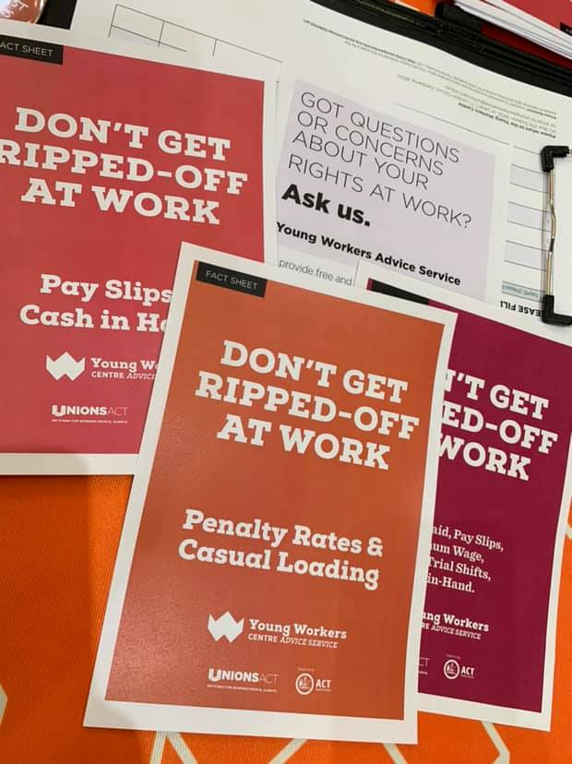
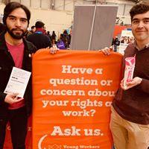
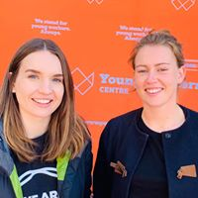
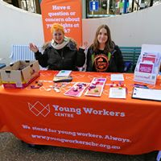
Notes:
Outreach program – including schools

Slide 7
Notes:
Skills development and training young workers

Slide 8
