Slide 1
HOSPO VOICE
BUILDING AUSTRALIA’S FIRST DIGITAL UNION

Slide 2
https://drive.google.com/file/d/1PkjKdsdW1zEmoyvhkVjjn1VY8J6yVceD/view?usp=sharing

Slide 3
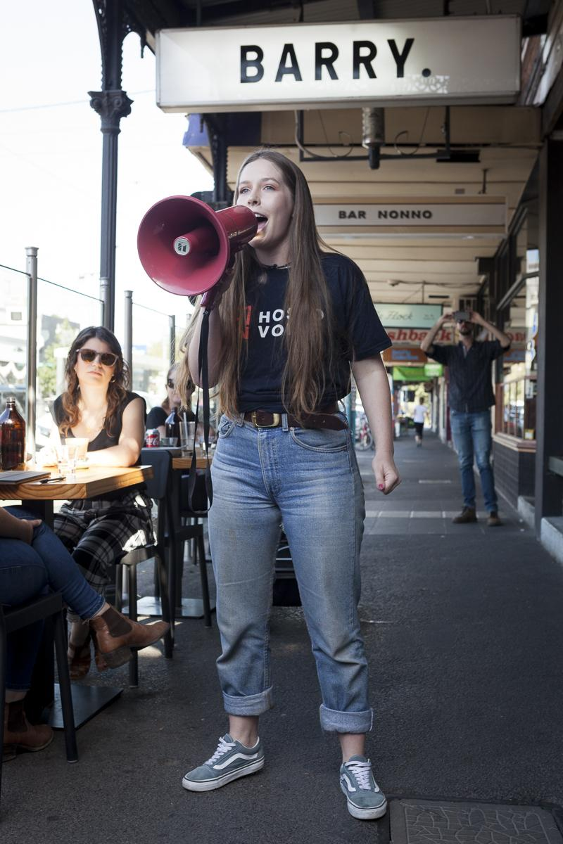

Slide 5
CHECK MY PAY

Slide 6
CHECK MY PAY

Slide 7
HARASSMENT DIARY

Slide 8
RECORD MY HOURS

Slide 9
FACT SHEETS
FACT SHEETS ON:
Breaks
WorkCover
Free Work Trials
Sexual Harassment
Underpayments
Cash In Hand Work
Workplace Bullying

Slide 10
HOSPO HELP

Slide 11
HOSPO HELP

Slide 16
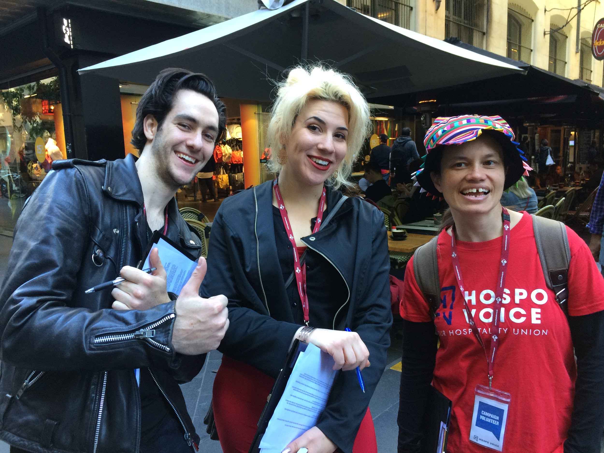

Slide 17
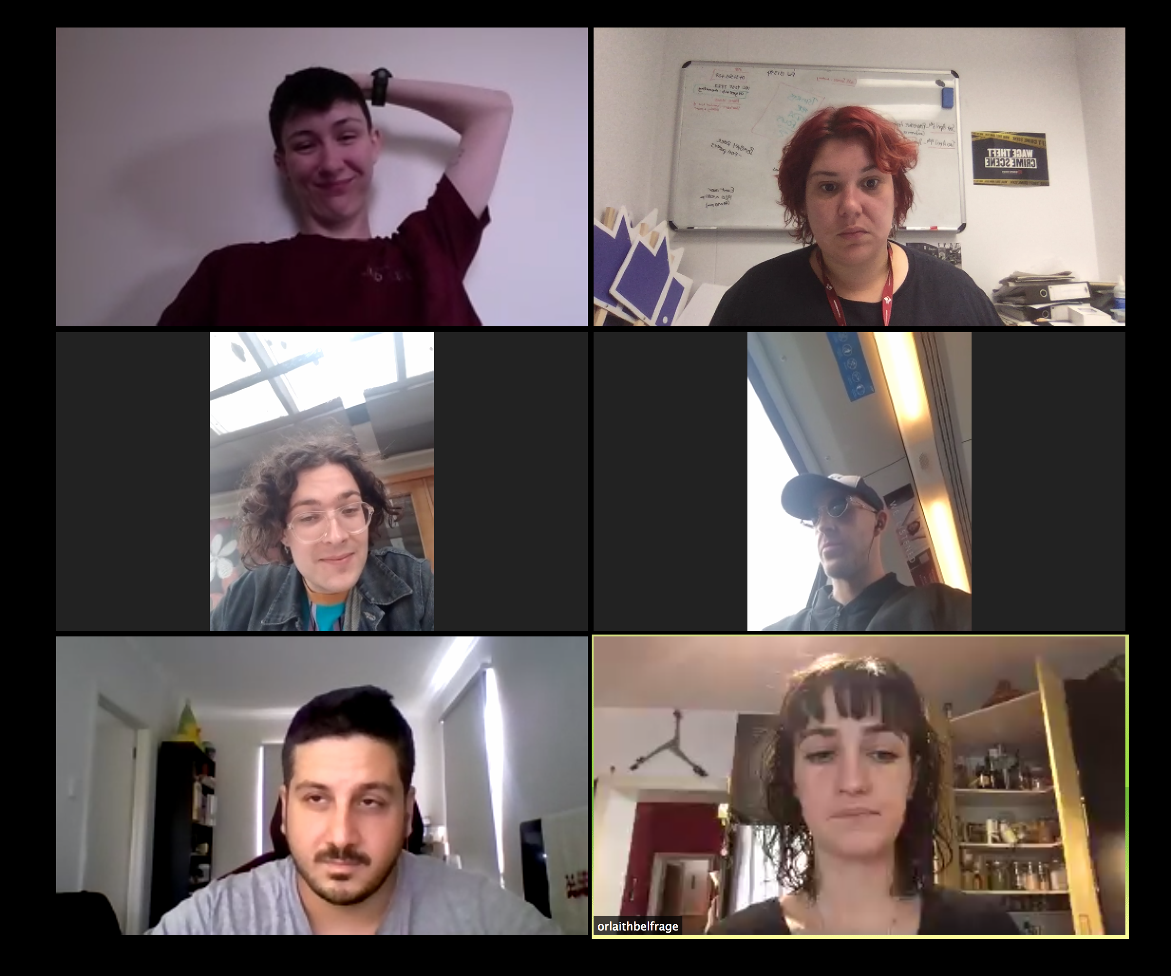

Slide 18
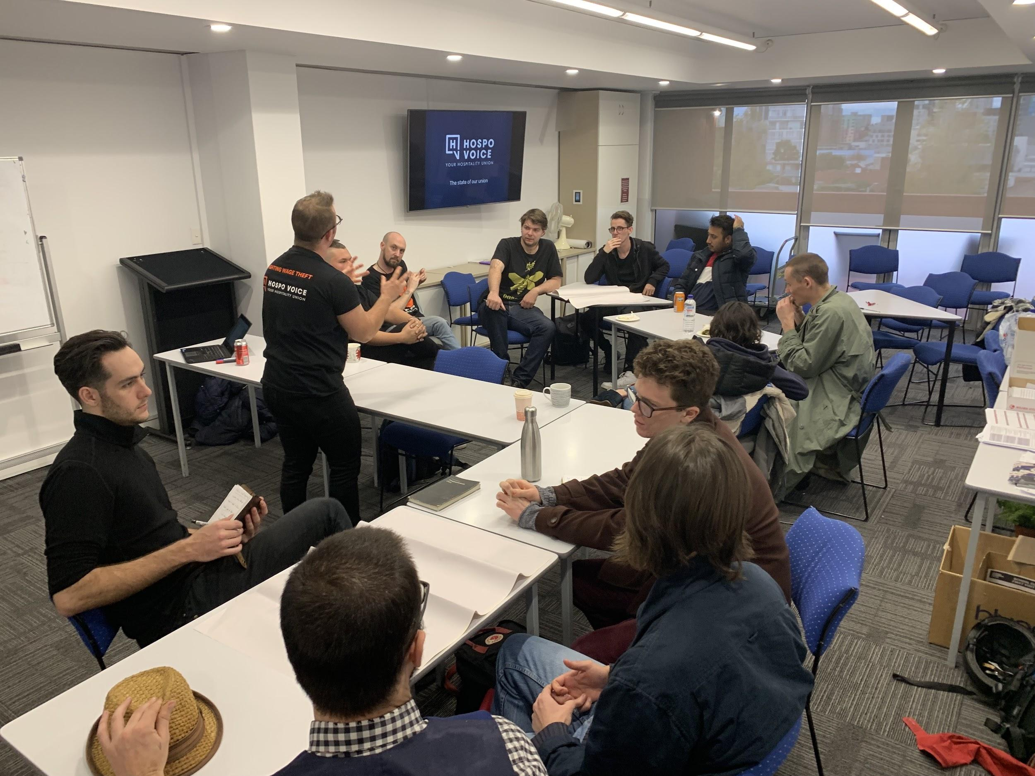

Slide 20
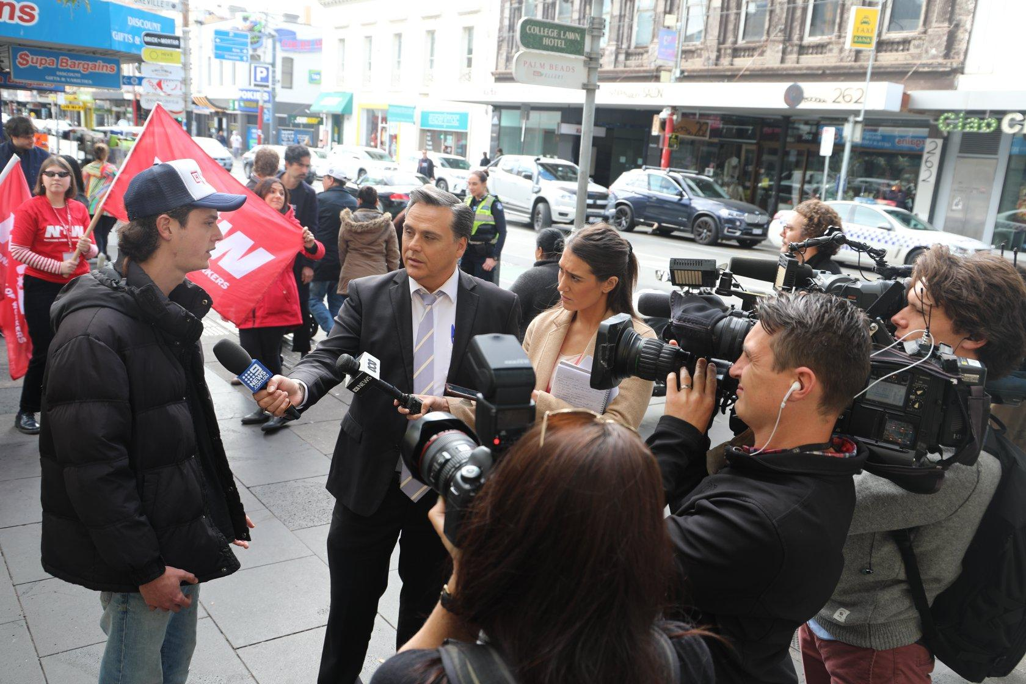

Slide 22
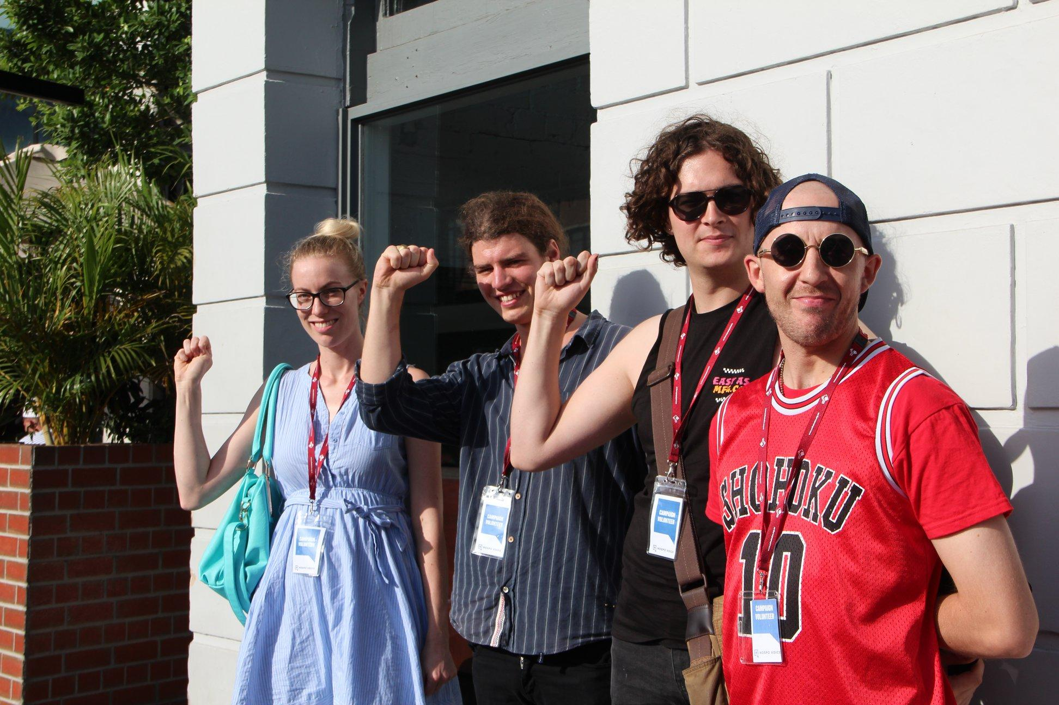

Slide 23
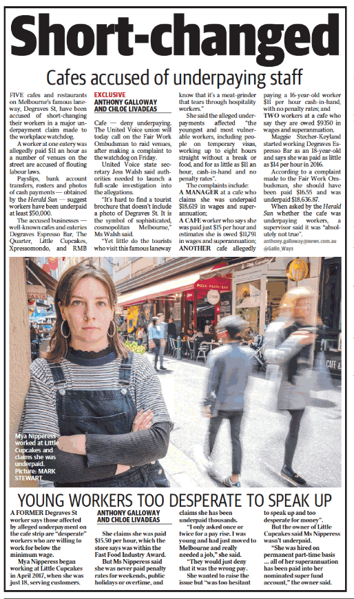
#WINNING

Slide 24
