Slide 1
TAFE in Union Town Where to from here?
October 2019

Slide 2
110,800 fewer TAFE NSW students in 2017 61,300 fewer students overall
1996
TAFE: 374,700
Private Providers: 8,300
Total: 484,400
Population: 6,038,696
2017
TAFE: 263,900
Private Providers:140,600
Total: 423,100
Population: 7,992,000

Slide 3
NSW TAFE student numbers 1996-2017
Notes:
National Centre for Vocational Education Research. (2018). Historical time series of government-funded vocational education and training from 1981 to 2017.

Slide 4
What has happened to NSW TAFE under the coalition government?
Total funding decreased by 14%
State government funding decreased by 24%
Funding allocated contestably increased by 234%

Slide 5
Quantum of funding allocated competitively has increased
Notes:
Productivity Commission – Report on Government Services 2019 – Vocational Education and Training derived from Table 5A.5 – Allocation of government real funds for VET 2017 dollars

Slide 6
Who benefits from Smart and Skilled?
In 2013 $309.9m, or 17% funding was contestable
In 2017, $723m, or 47% of total funding allocated contestably.
$298m, or 41% of the contestable funding went to private for-profit providers.

Slide 7
Funding allocated competitively has grown from 17% in 2013 to 48% in 2017

Slide 8
Enrolments in vocational education have declined by 15% since 2008
TAFE declined by 27%
In 2008, TAFE “market share” was almost 87%, and private providers 9%. By 2017, TAFE share had dropped to 74%, whilst private providers share had increased to 23%
Private providers increased by 111%
Delivery in TAFEs from 2008 to 2017 fell by 27%, by 43% in the community sector by 43% but increased in private providers by 111%.

Slide 9
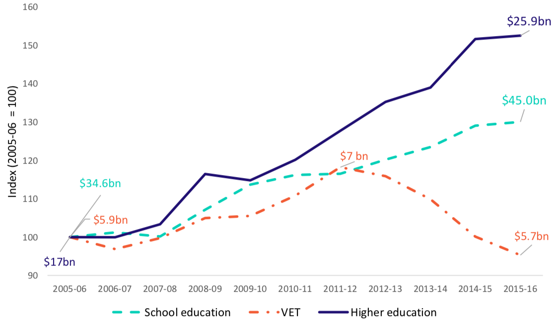
Vocational Education is the lowest funded education sector – and it is getting worse
Notes:
Expenditure on education by sector 2005-06 to 2015-16 (base year 2005-06 = 100)
S. Pilcher and K. Torii (2017). Expenditure on education and training in Australia: Update and analysis, Mitchell Institute policy paper No. 05/2017. Mitchell Institute, Melbourne. Available from: www.mitchellinstitute.org.au
Expenditure in the VET sector has declined dramatically, to below levels seen over 10 years earlier in real terms. From 2005-06 to 2015-16 national expenditure fell by 4.7 per cent, or $280 million, when adjusted for inflation. In the most recent reporting year, between 2014-15 and 2015-16, VET expenditure fell by 5 per cent in real terms.3
Some of the decline in VET expenditure over this period has been offset by increasing Commonwealth Government outlays to training providers through VET FEE-HELP.
However, at the same time the National Partnership Agreement on Skills Reform expired on 30 June 2017. This has been replaced by the Skilling Australians Fund, which has been allocated between $350 and $390 million each year from 2017-18.4 It has yet to receive any funding through the proposed levy on firms employing skilled migrants (to be implemented from 1 January 2018).
In stark contrast, higher education expenditure from all sources has grown rapidly, with a 52.6 per cent increase over the eleven year period. Although the particularly sharp growth appears to have slowed in the last year.
While higher education expenditure also includes spending from universities’ own resources, the shift to a demand- driven system in 2012, in which student numbers were uncapped, led to a strong increase in enrolments in the years that followed. A slower increase in higher education expenditure from 2014-15 to 2015-16 may indicate that the initial period of rapid growth associated with meeting unmet student demand may have come to an end. From 2015 to 2016 commencing Commonwealth supported students grew only 1.1 per cent (Commonwealth Department of Education and Training 2017).
Further, a recent report on the higher education sector’s finances shows the largest growth in revenue from 2015 to 2016 was from international students (TEQSA 2017).
School education expenditure increased strongly over the last decade – increasing by $10.4 billion in real terms from 2005-06 to 2015-16. This represents an increase of 30 per cent. However, it has stabilised in the last year, with only a 1 per cent ($346 million) increase between 2014-15 and 2015-16.
This steady increase in school education expenditure is largely in line with the growth in the everyday operating costs associated with increasing student numbers and wage inflation in the school sector. This is consistent with analysis undertaken by the Grattan Institute which provides a breakdown of the $10 billion increase in school funding between 2004-05 and 2013-14 reported by the Productivity Commission (Goss 2016).
Disparities in expenditure patterns between education sectors are concerning – particularly as it continues in the absence of coherent policy and long-term planning, as highlighted in previous years’ publications (Noonan, Burke, Wade, & Pilcher, 2014, 2015, O'Connell and Torii 2016).

Slide 10
Where to now for TAFE?
Promoting and rebuilding TAFEs as anchor institution in local communities, especially in regional and rural areas
Rebuilding the TAFE teaching profession including through defending teaching and working conditions, teaching qualifications and professional development and remuneration
Working with other unions and social partners to rebuild the connection between a broadly conceived vocational education and decent work
Ensuring students are at the centre of new social policy in the sector

Slide 11
New social policy and research
Teachers – qualifications and professional development, dual professionals, working conditions
Students – powerful, knowledgeable worker-citizens
TAFEs – institutions, well-funded, linked to community and society
Equality and fairness
Society not economy
Decent work and powerful workers

Slide 12
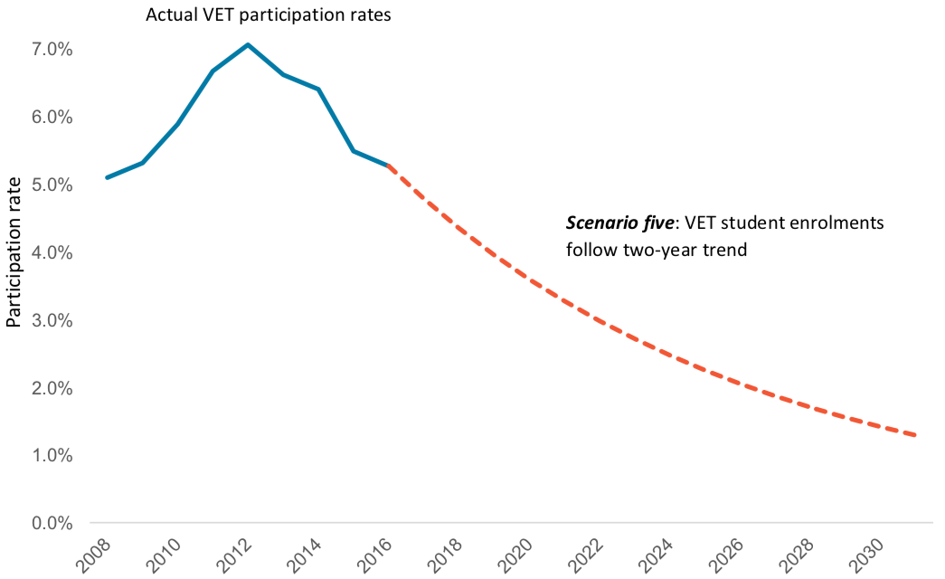
If nothing changes … Where current policy will lead us
Notes:
Mitchell Institute – Rethinking and Revitalising tertiary education in Australia Dawkins, Hurley and Noonan p1

