Slide 1
Campaigning Public Services in the Regions
Union Town Conference
Notes:
Hello and welcome.
Introduce yourself
Acknowledgement of country
Housekeeping
Mobiles phone off/silent please
Questions at end please – not the forum for individual issues

Slide 2
Overview of Total PSA Membership
46 % Percentage of members work in country
46 % Percentage of members work in country

Slide 3
Regional Membership PSA
Notes:
The other category is ‘Country’. This category comprises all Local Government areas in New South Wales outside of the Greater Sydney area.

Slide 4
Planning
Use Election to press our influence
10 month lead in
Planned where we have members and delegate capacity
Planned campaigns around our members work

Slide 5
Developing the Foundations
Public Services Sustain Regional Communities and their Communities
The Economic Importance of Public Services in Regional Communities in NSW By Troy Henderson The Centre for Future Work at the Australia Institute May 2018

Slide 6
Multiple Campaigns
Targeted message depending on workers
General Campaigns about jobs and services, privatization
Targeted member campaigns about issues in that Agency
Flipped into targeted election campaign due to Electoral Laws

Slide 7
Engagement
Public Service Delegate meetings
Phone Banking
Member Turn Out for Campaign Events
Public Service meet the candidates forums
Radio Advertising
Social Media
Events
Post engagement surveys

Slide 8
Building Union Community
PSA in Regions
District Committees being reformed
District Committees supporting community of workers through Unions NSW Community Unions
6 regions with increase in staffing of Organisers with an additional 4 Regional Organisers

Slide 10
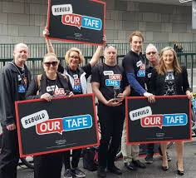
Targeted around communities

Slide 11
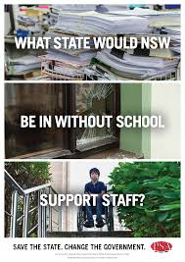
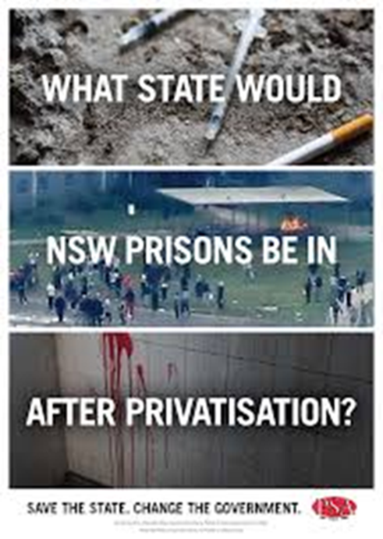
Targetted Internal and External

Slide 12
Main Themes after caller identifying
Stopping the privatisation of public services, including Corrective Services, rebuilding TAFE and reinstating a public safety net for disability services.
The end of Benchmarking in Corrective Services
Fairer pay and conditions for NSW public servants, including for the scrapping of 2.5% wage cap.
Insecure work in the public sector such as casualisation, and labour hire to halt.
The scrapping of the 12% (over four years) efficiency dividend.
Improved access to workplace flexibility.
A fairer workplace system to keep the employer in check.

Slide 13
Wins (of sorts)
Election Promises from all sides on privatization, rebuilding TAFE
ALP and Greens promised to scrap the wages cap and efficiency dividend
Deputy Premier promises
“No regional job losses”

Slide 14
Win
PSA has grown by 1600 net members this year
Members are aware that we are fighting for them at work and in the political sphere;
Delegates have been filling regional training courses

