Slide 1
#Uniontown Conference 30-31 0ctober 2019
Georgine Clarsen NTEU

Slide 2
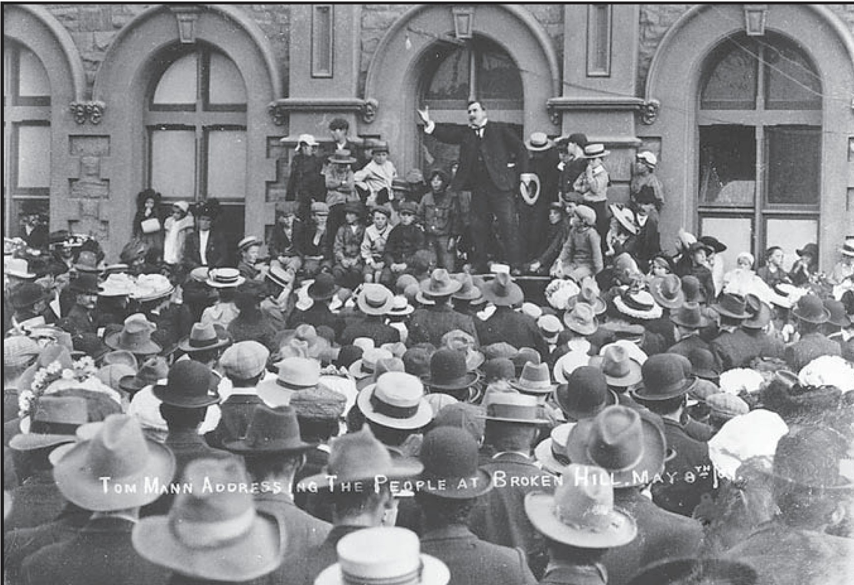

Slide 3
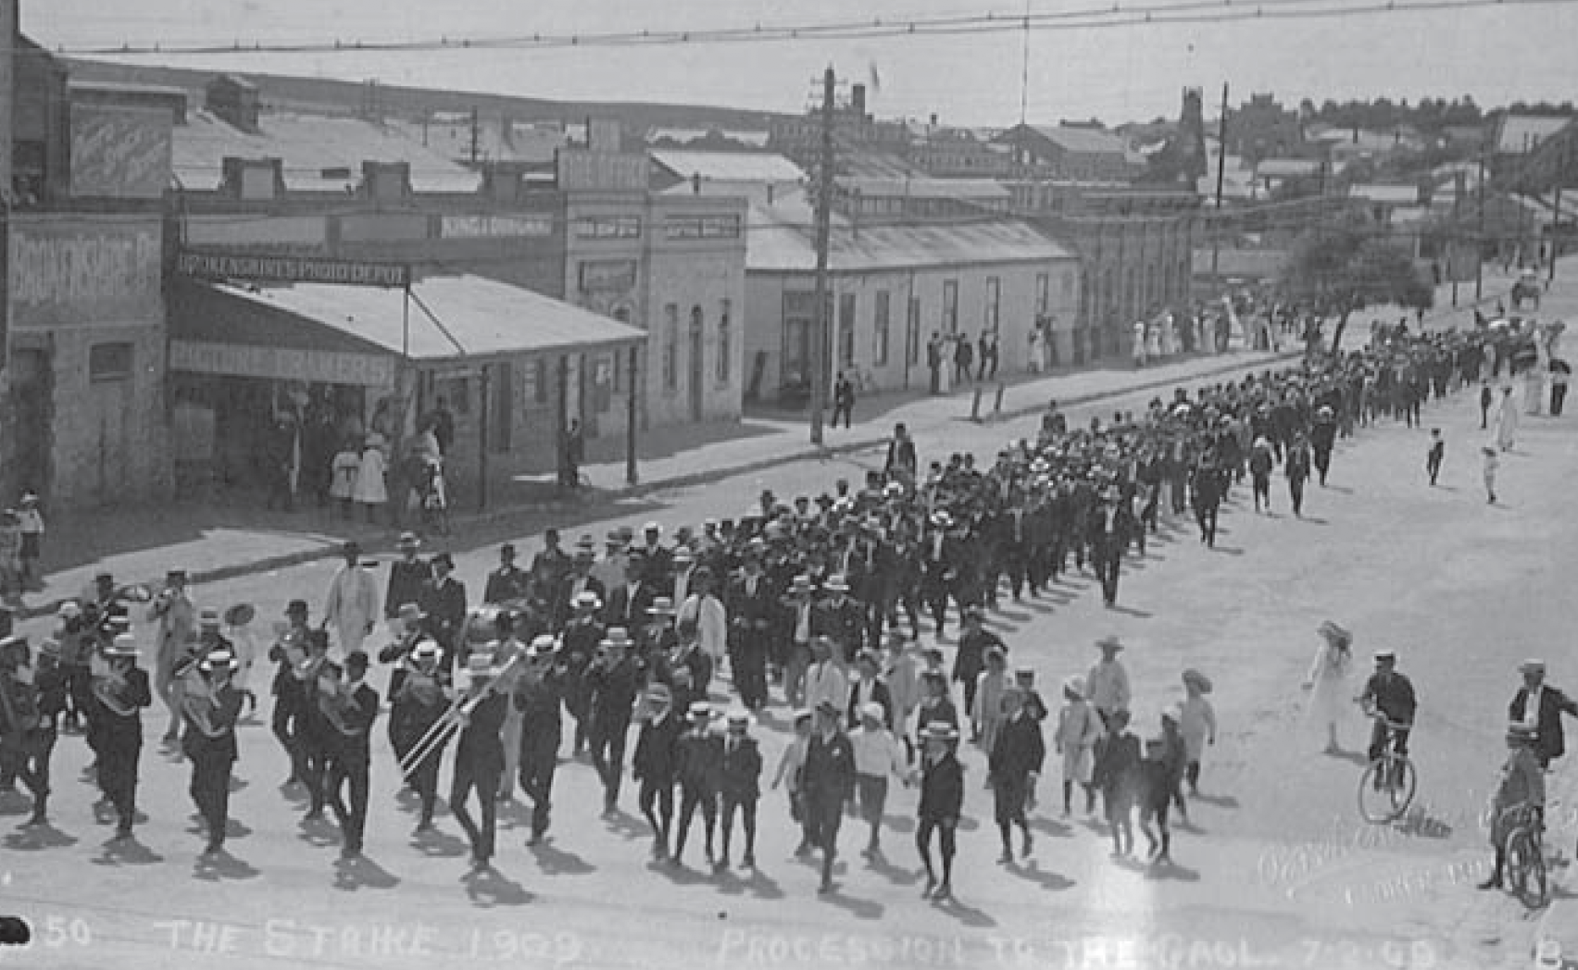

Slide 4
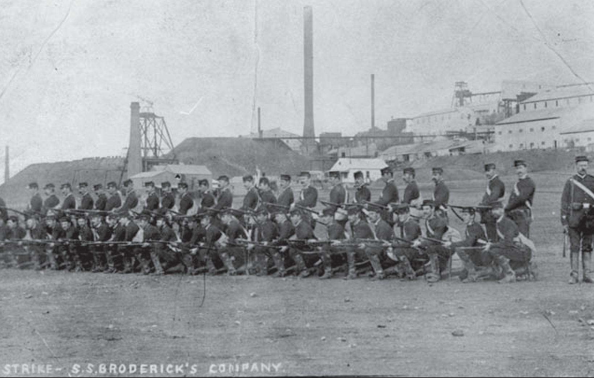

Slide 5
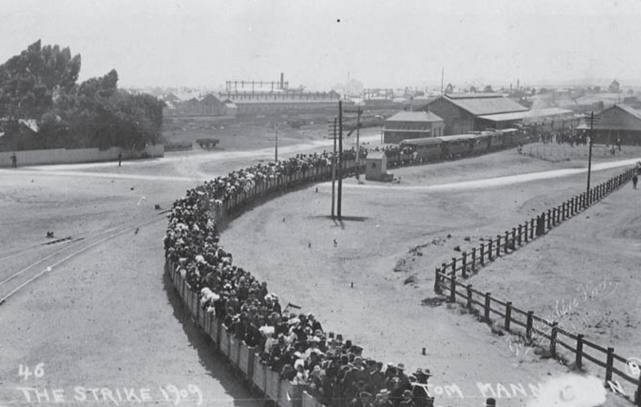

Slide 6
ARU Banner, 1940s

Slide 7
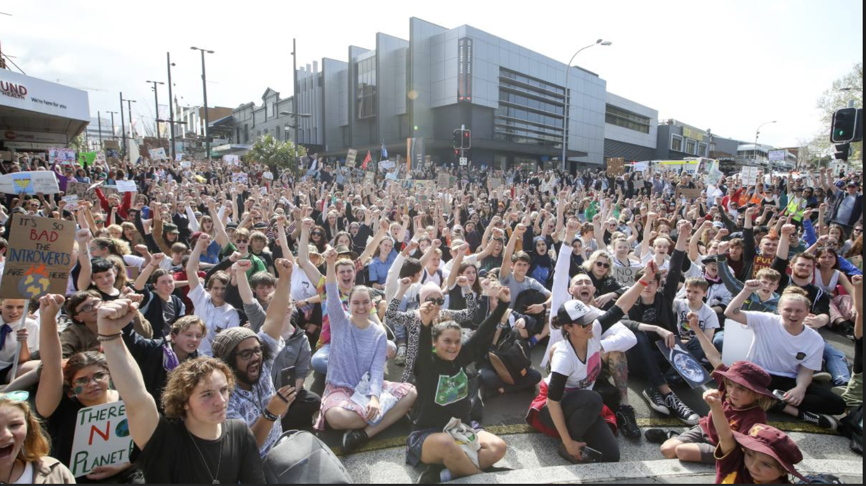

Slide 8
Thank you for your attention

