Slide 1
Regional Organisers Tool Kit
Survival Guide
ASU Organiser Sharon Callaghan
Australian Services Union

Slide 2
The Australian Services Union is tens of thousands of workers who have united to protect and improve our wages and working conditions. We work across Disability Services, Community Services, Public Transport, Public Water, Airlines, Shipping, Travel and IT.
Australian Services Union

Slide 3
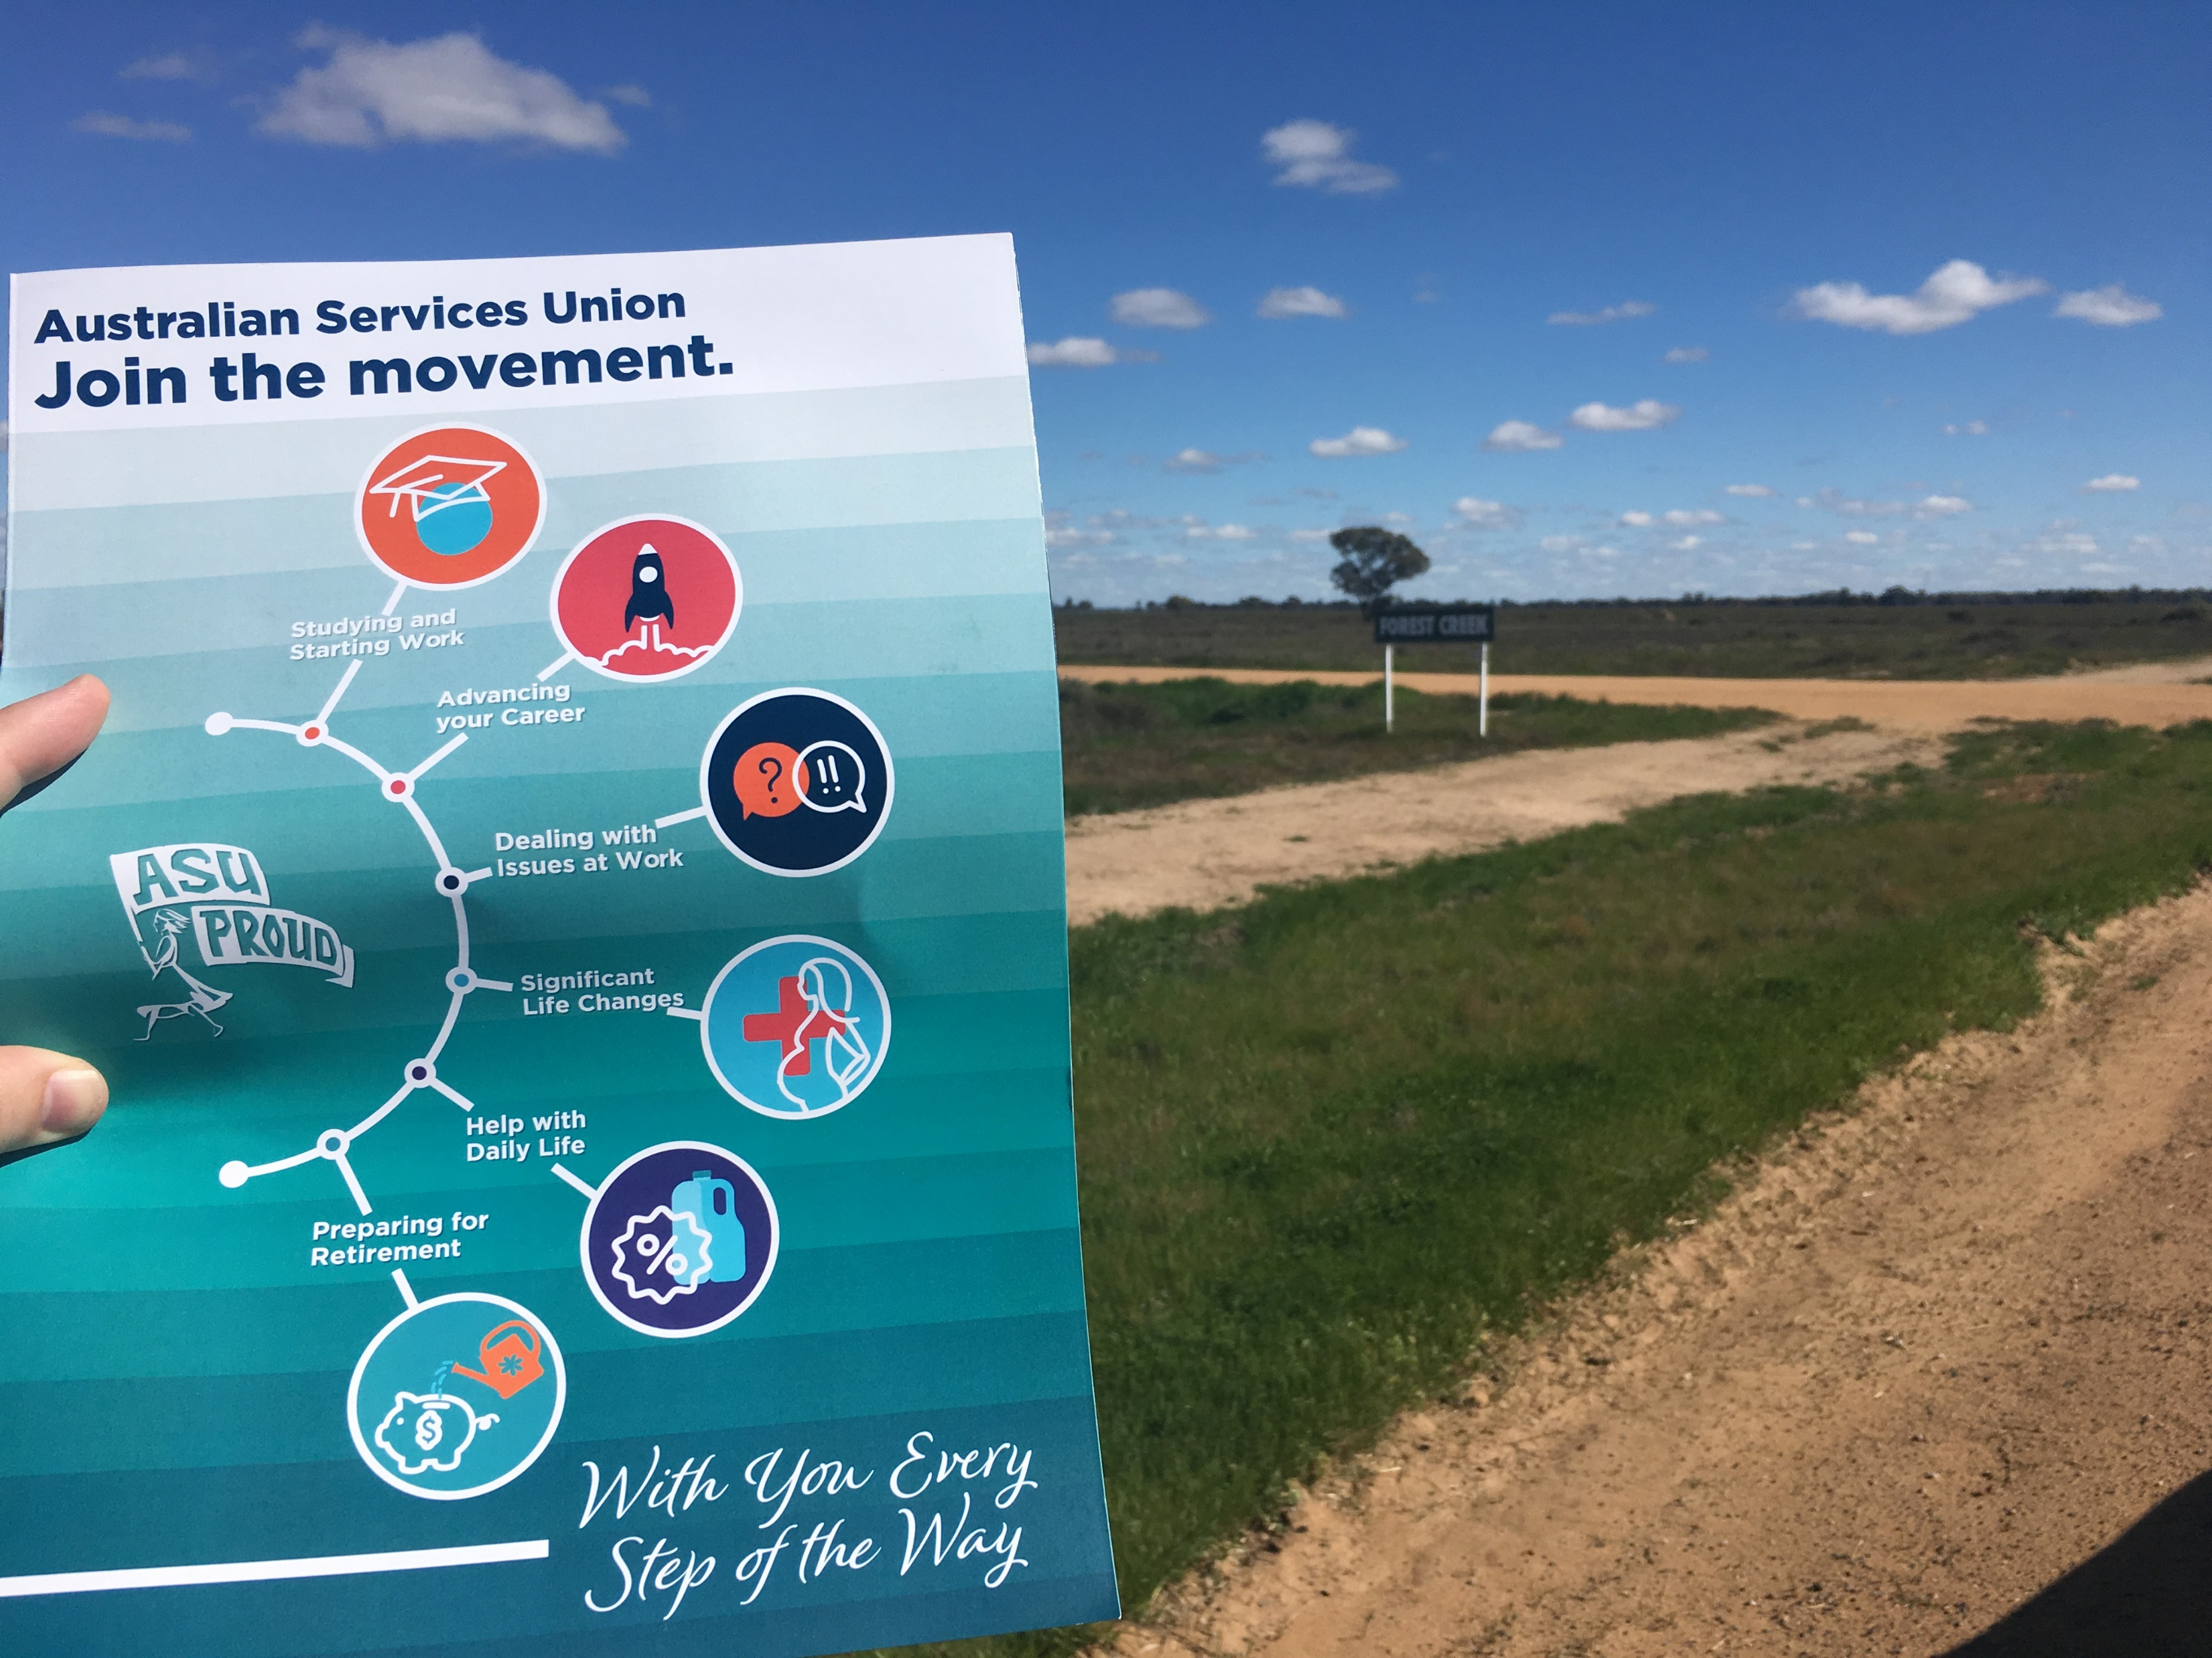
Regional Organising
Subdivisions
Town Halls
Rallies
Launches & Events
Email and phone communications
Regional media
Australian Services Union

Slide 4
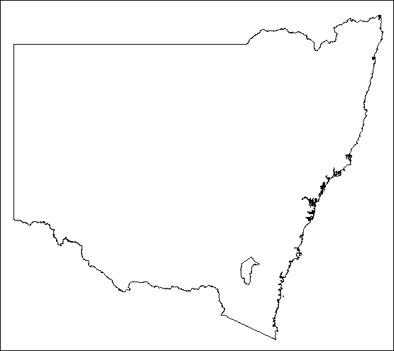
We have ASU offices in:
Redfern
Penrith
Wollongong
Newcastle
Lismore
Australian Services Union

Slide 5
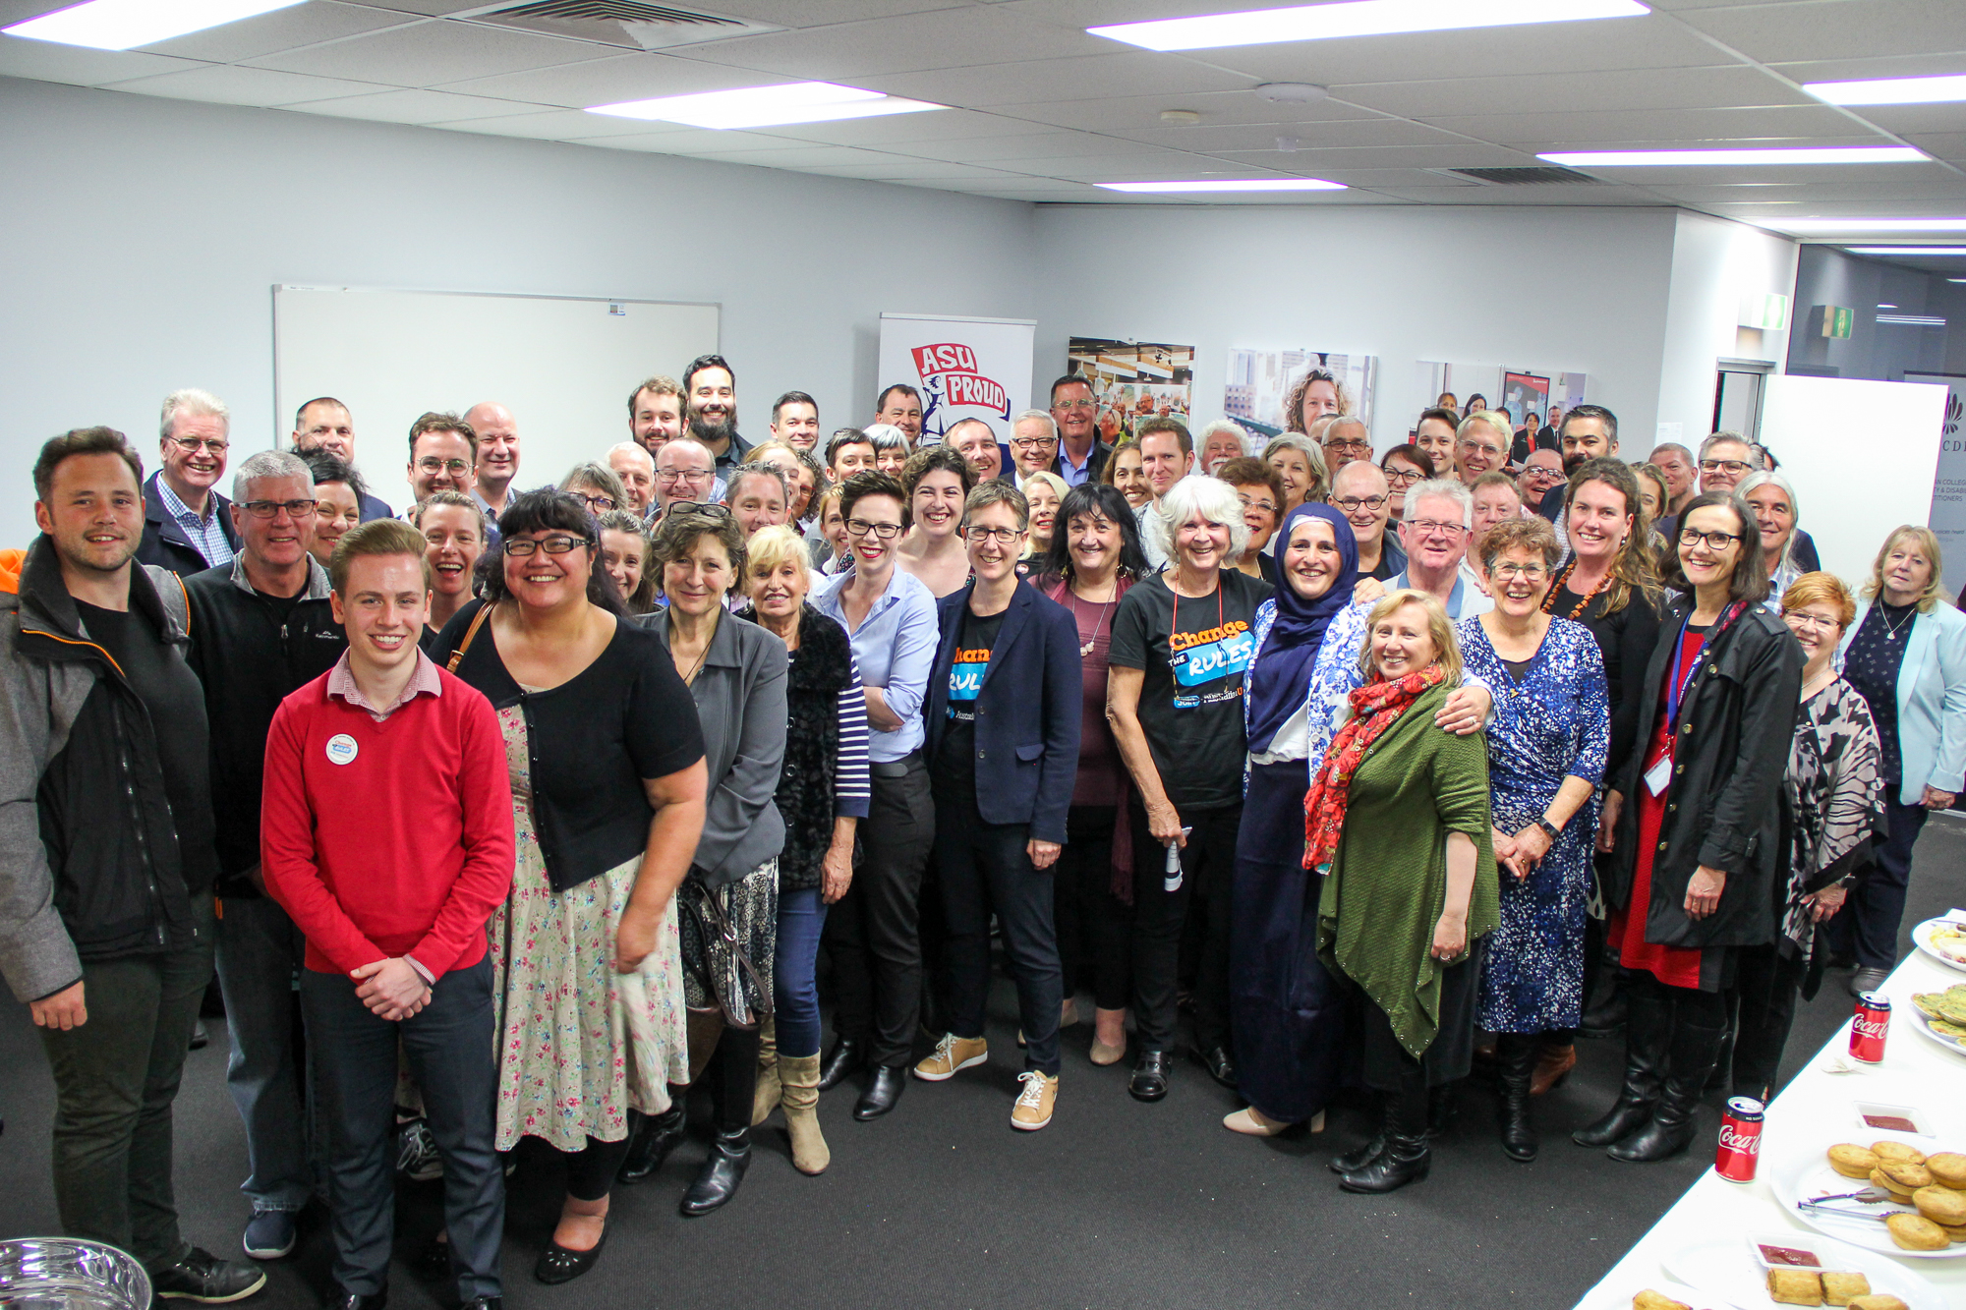
We use these offices as Regional Hubs for members and activists.
We hold meetings and events and have campaign materials available.
Australian Services Union

Slide 6
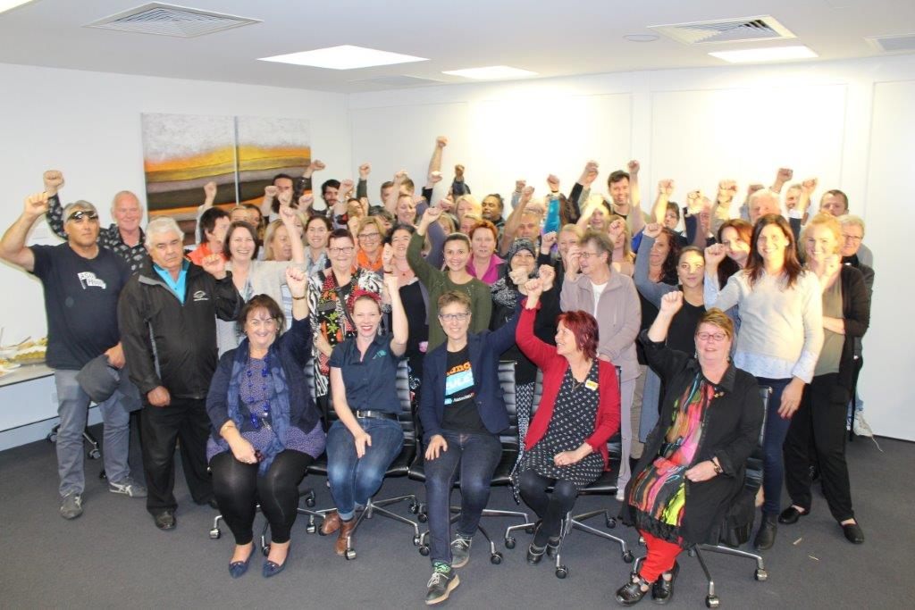
Regional Subdivision Meetings
We have union meetings at workplace, employer, sector, industry, and regional levels.
Australian Services Union

Slide 7
Regional Town Hall Meetings
All members are invited to meet up for a regional union meeting.
We call, email and send SMS reminders to maximise attendance.
Australian Services Union

Slide 8
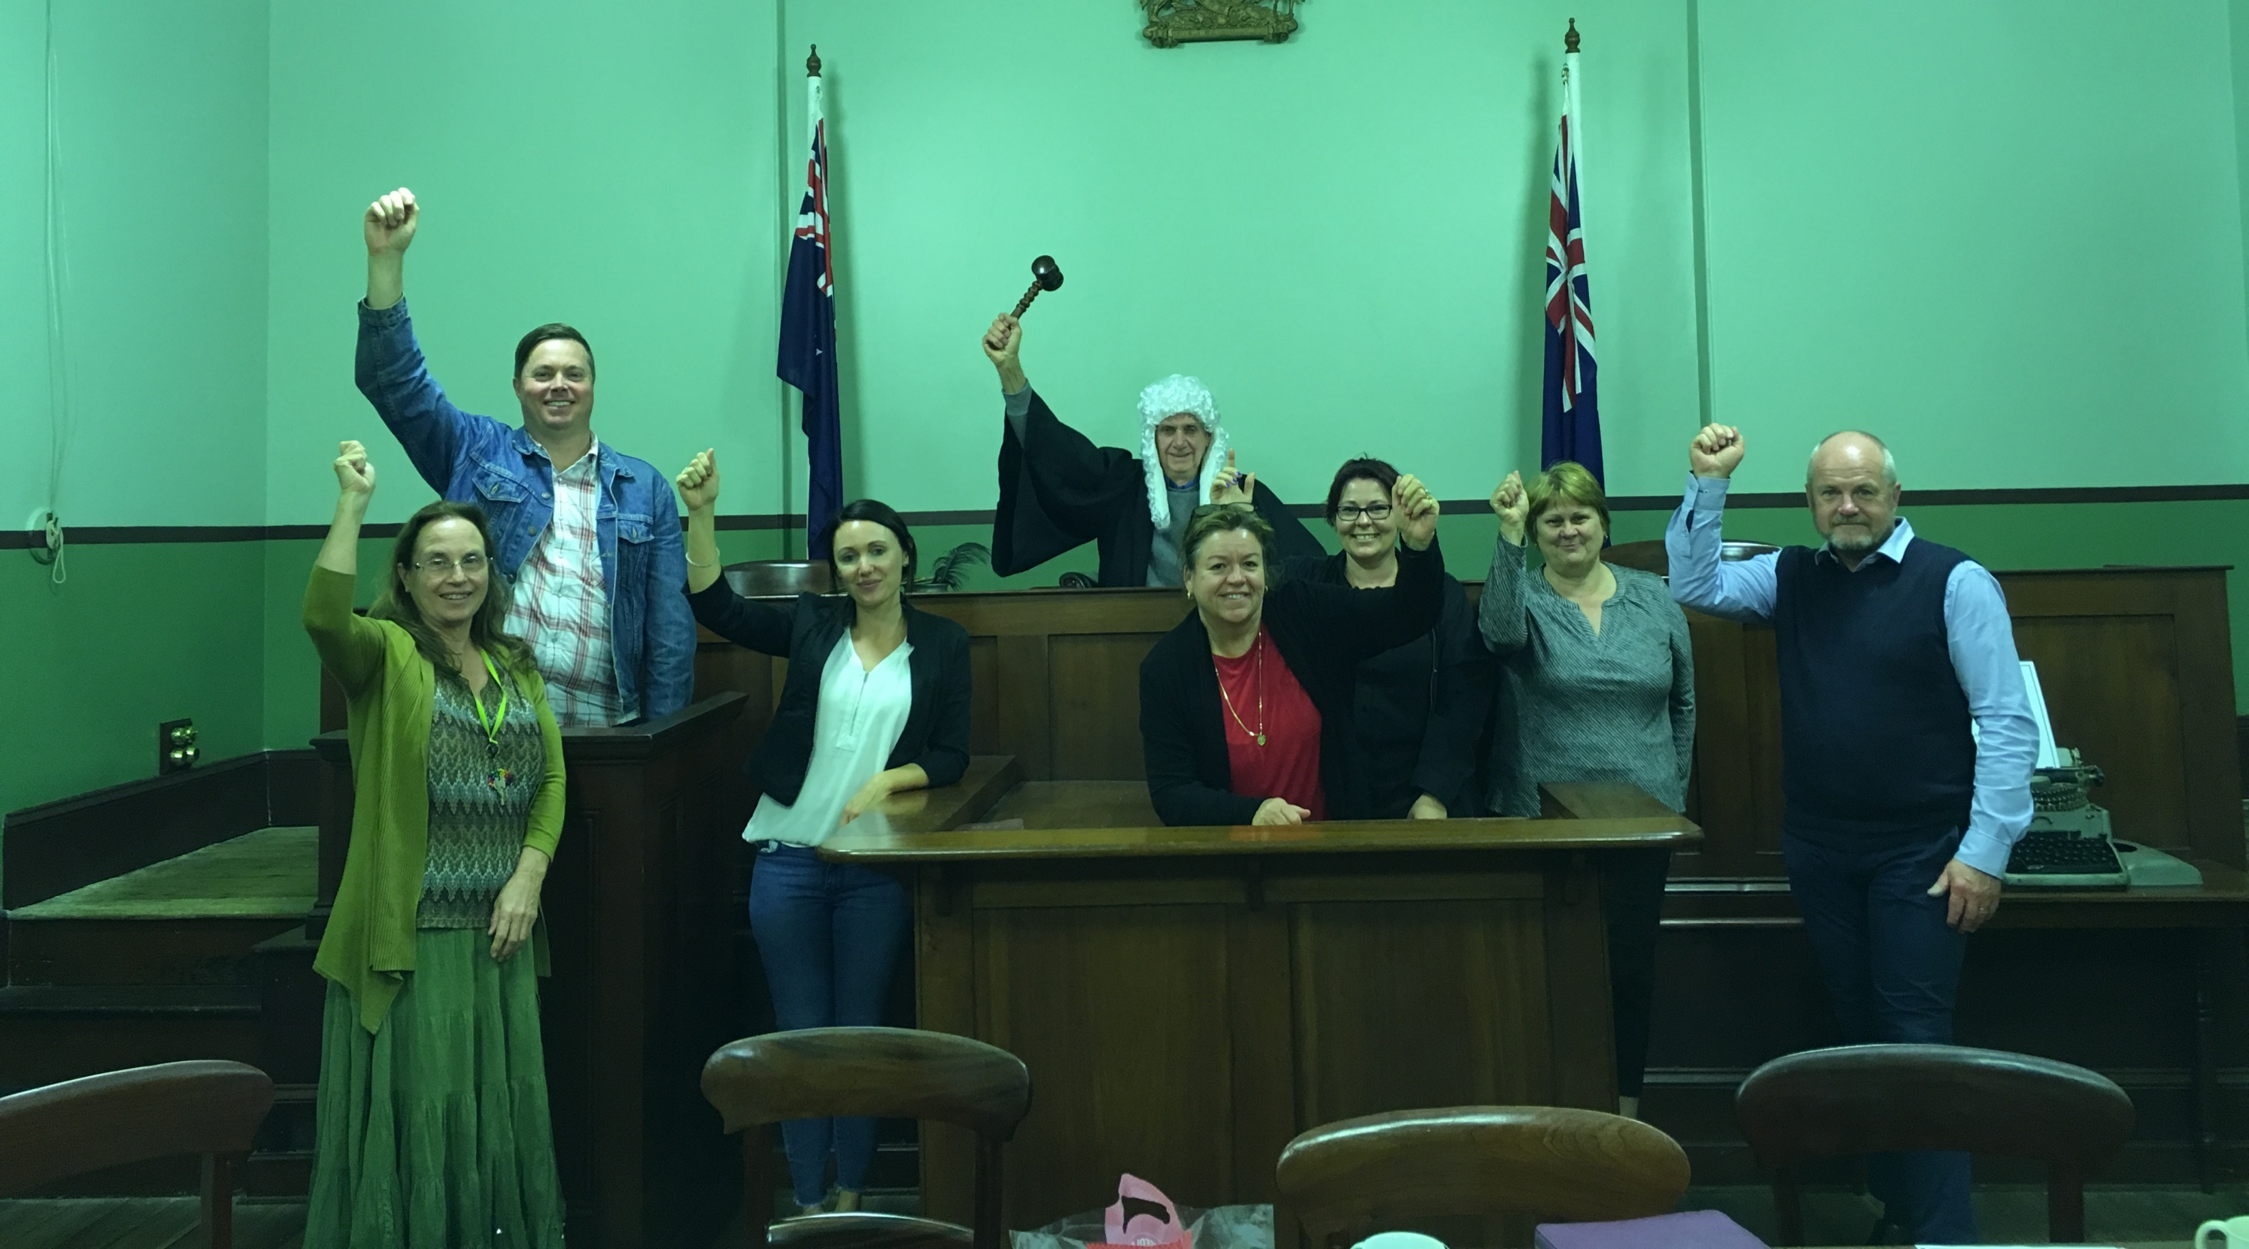
You can find some special places for union meetings – like these Port Macquarie members did!
Australian Services Union

Slide 9
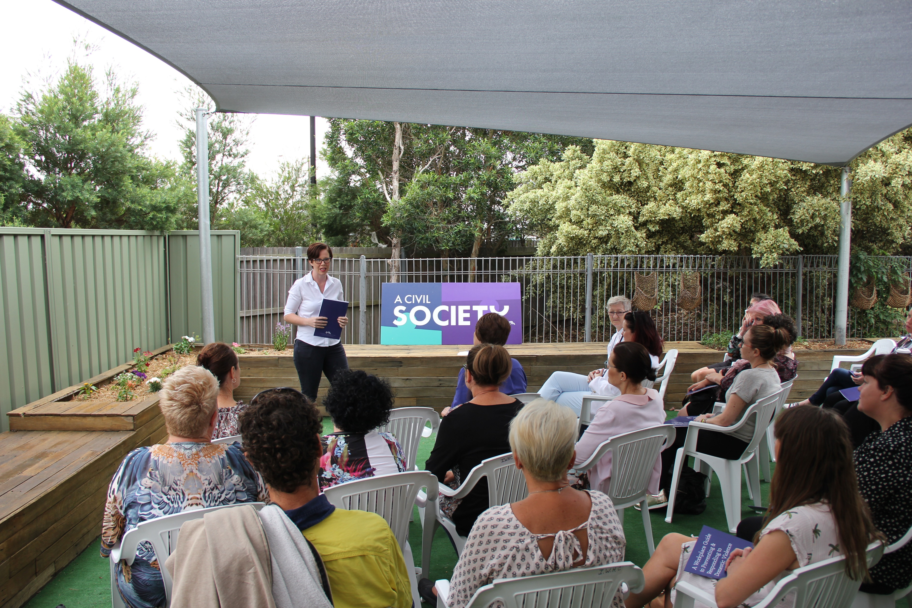
Regional launches
We launched our Preventing & Responding to DV in the Workplace Kit in the Illawarra and Canberra.
Australian Services Union

Slide 10
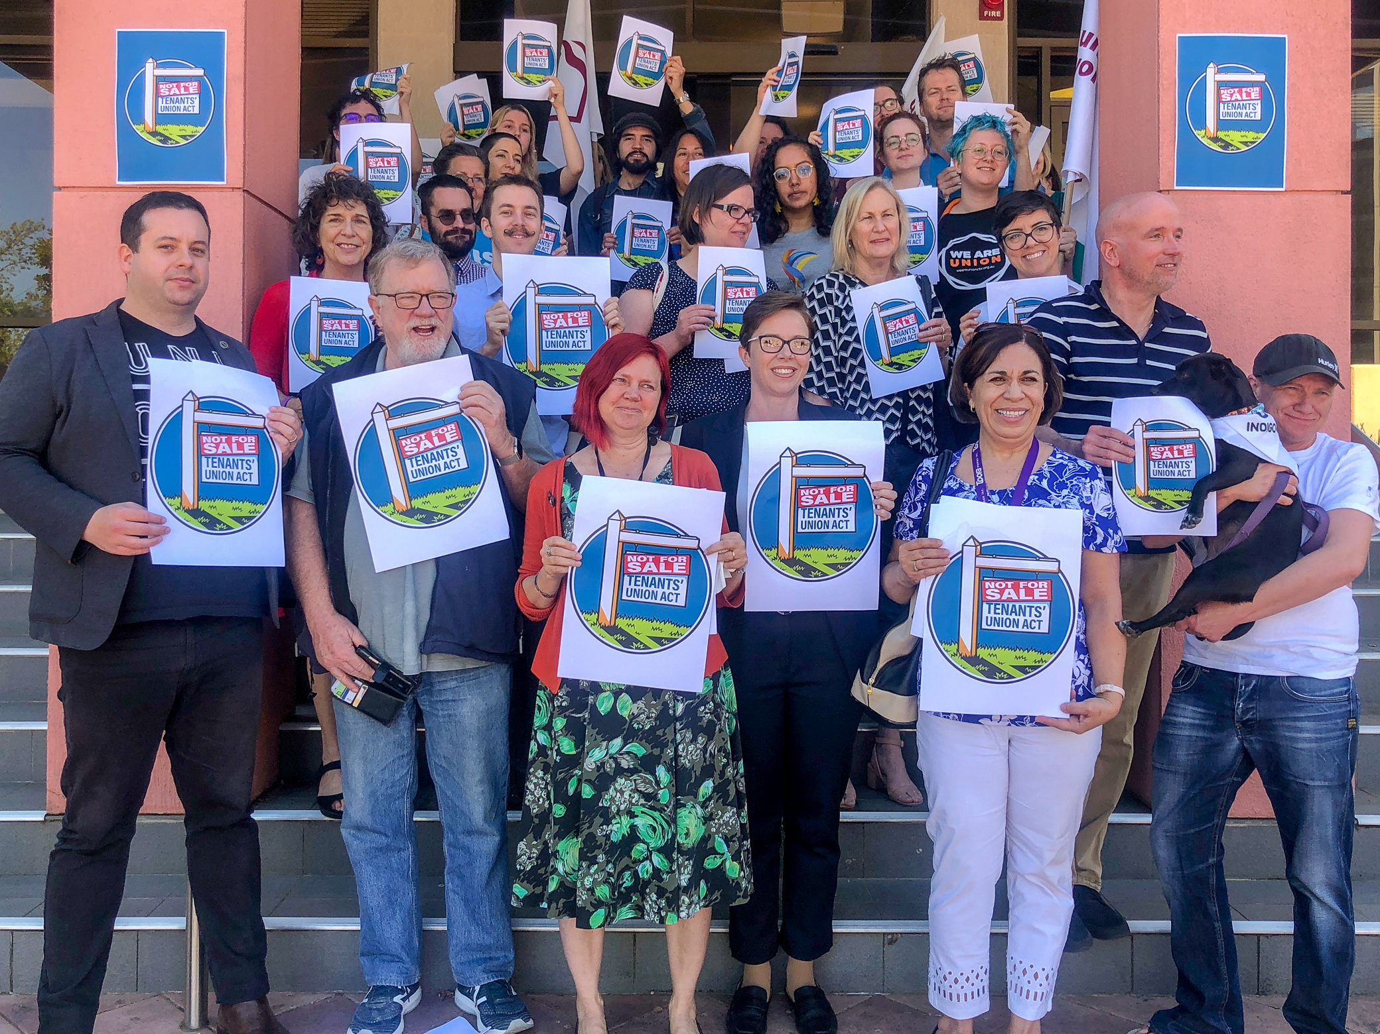
Save the Tenants’ Union ACT Campaign Launch
Australian Services Union

Slide 11
Regional Campaign Events
We Won’t Wait Campaign - Illawarra
Australian Services Union

Slide 12
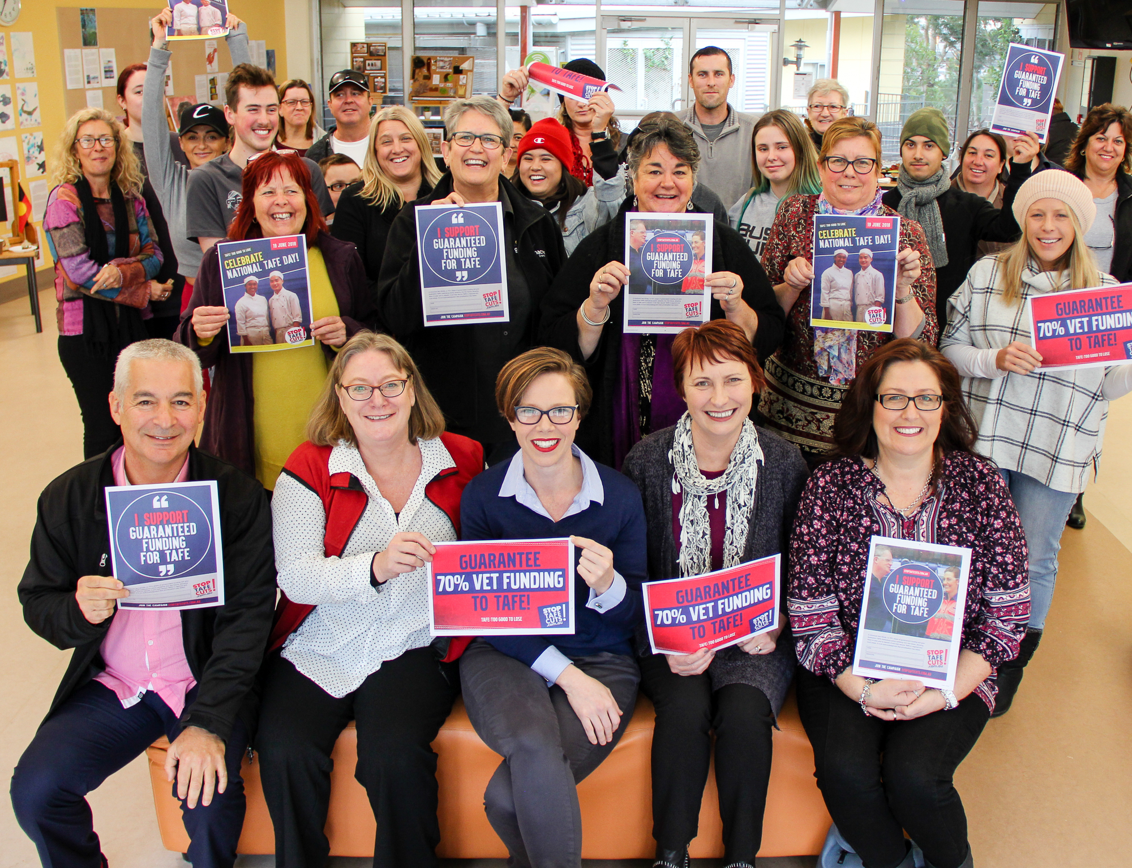
Australian Services Union

Slide 13
When we organise in our communtiies we can put pressure on local MPs to support our campaign demands.
Australian Services Union

Slide 14
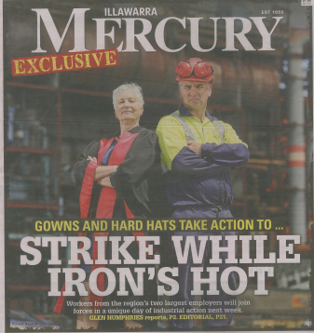
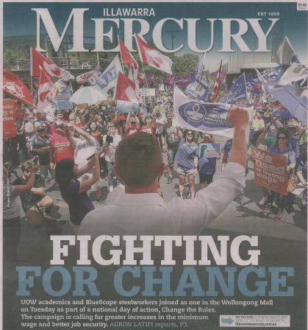
Local Media
Australian Services Union

Slide 15
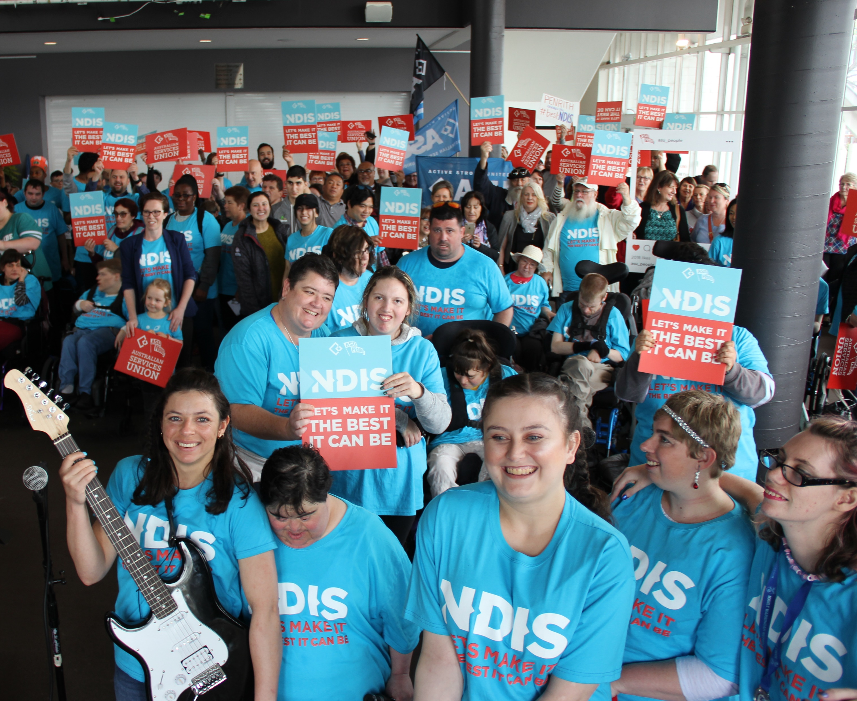
Penrith NDIS Rally
Australian Services Union

Slide 16
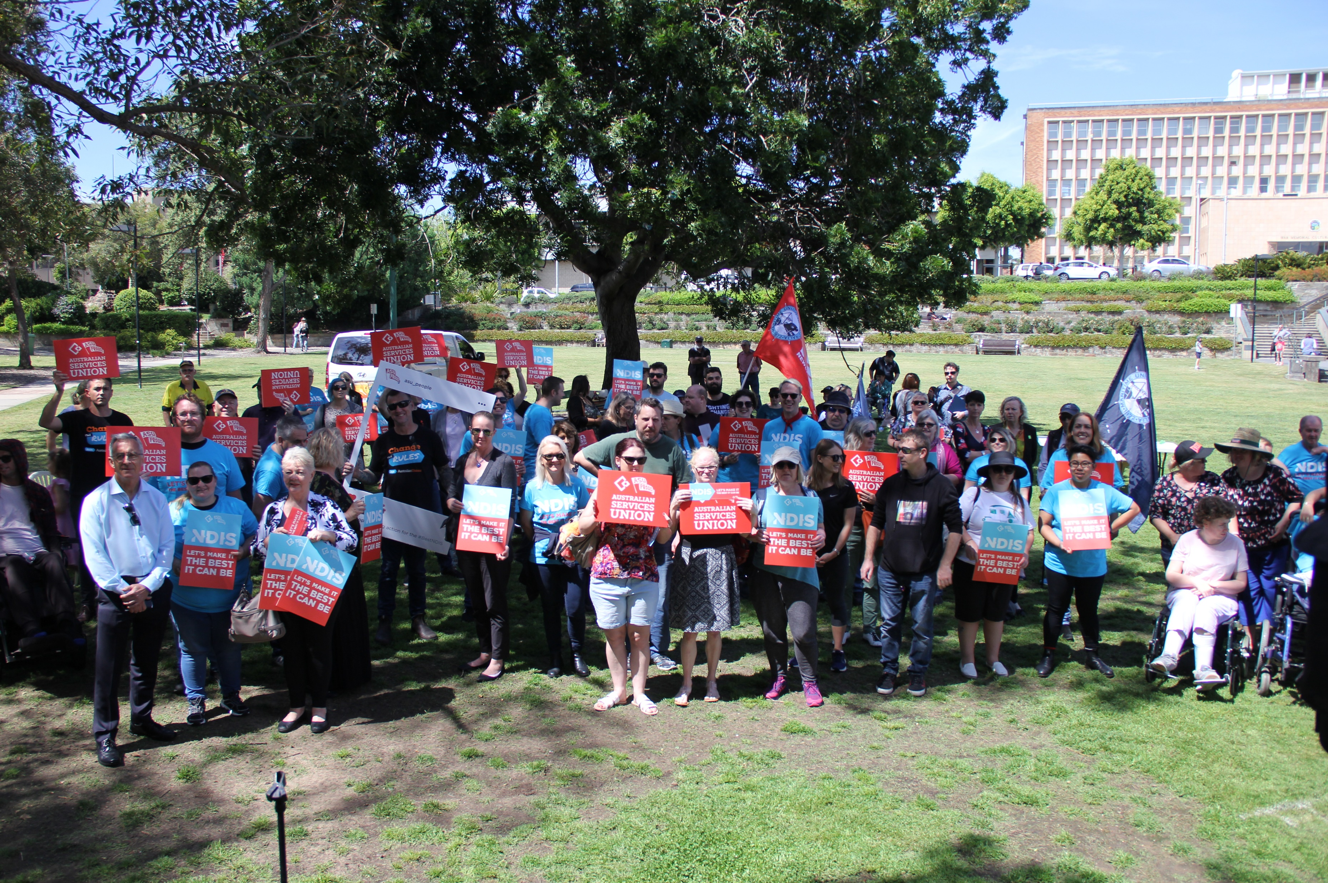
Newcastle rally
Australian Services Union

Slide 17
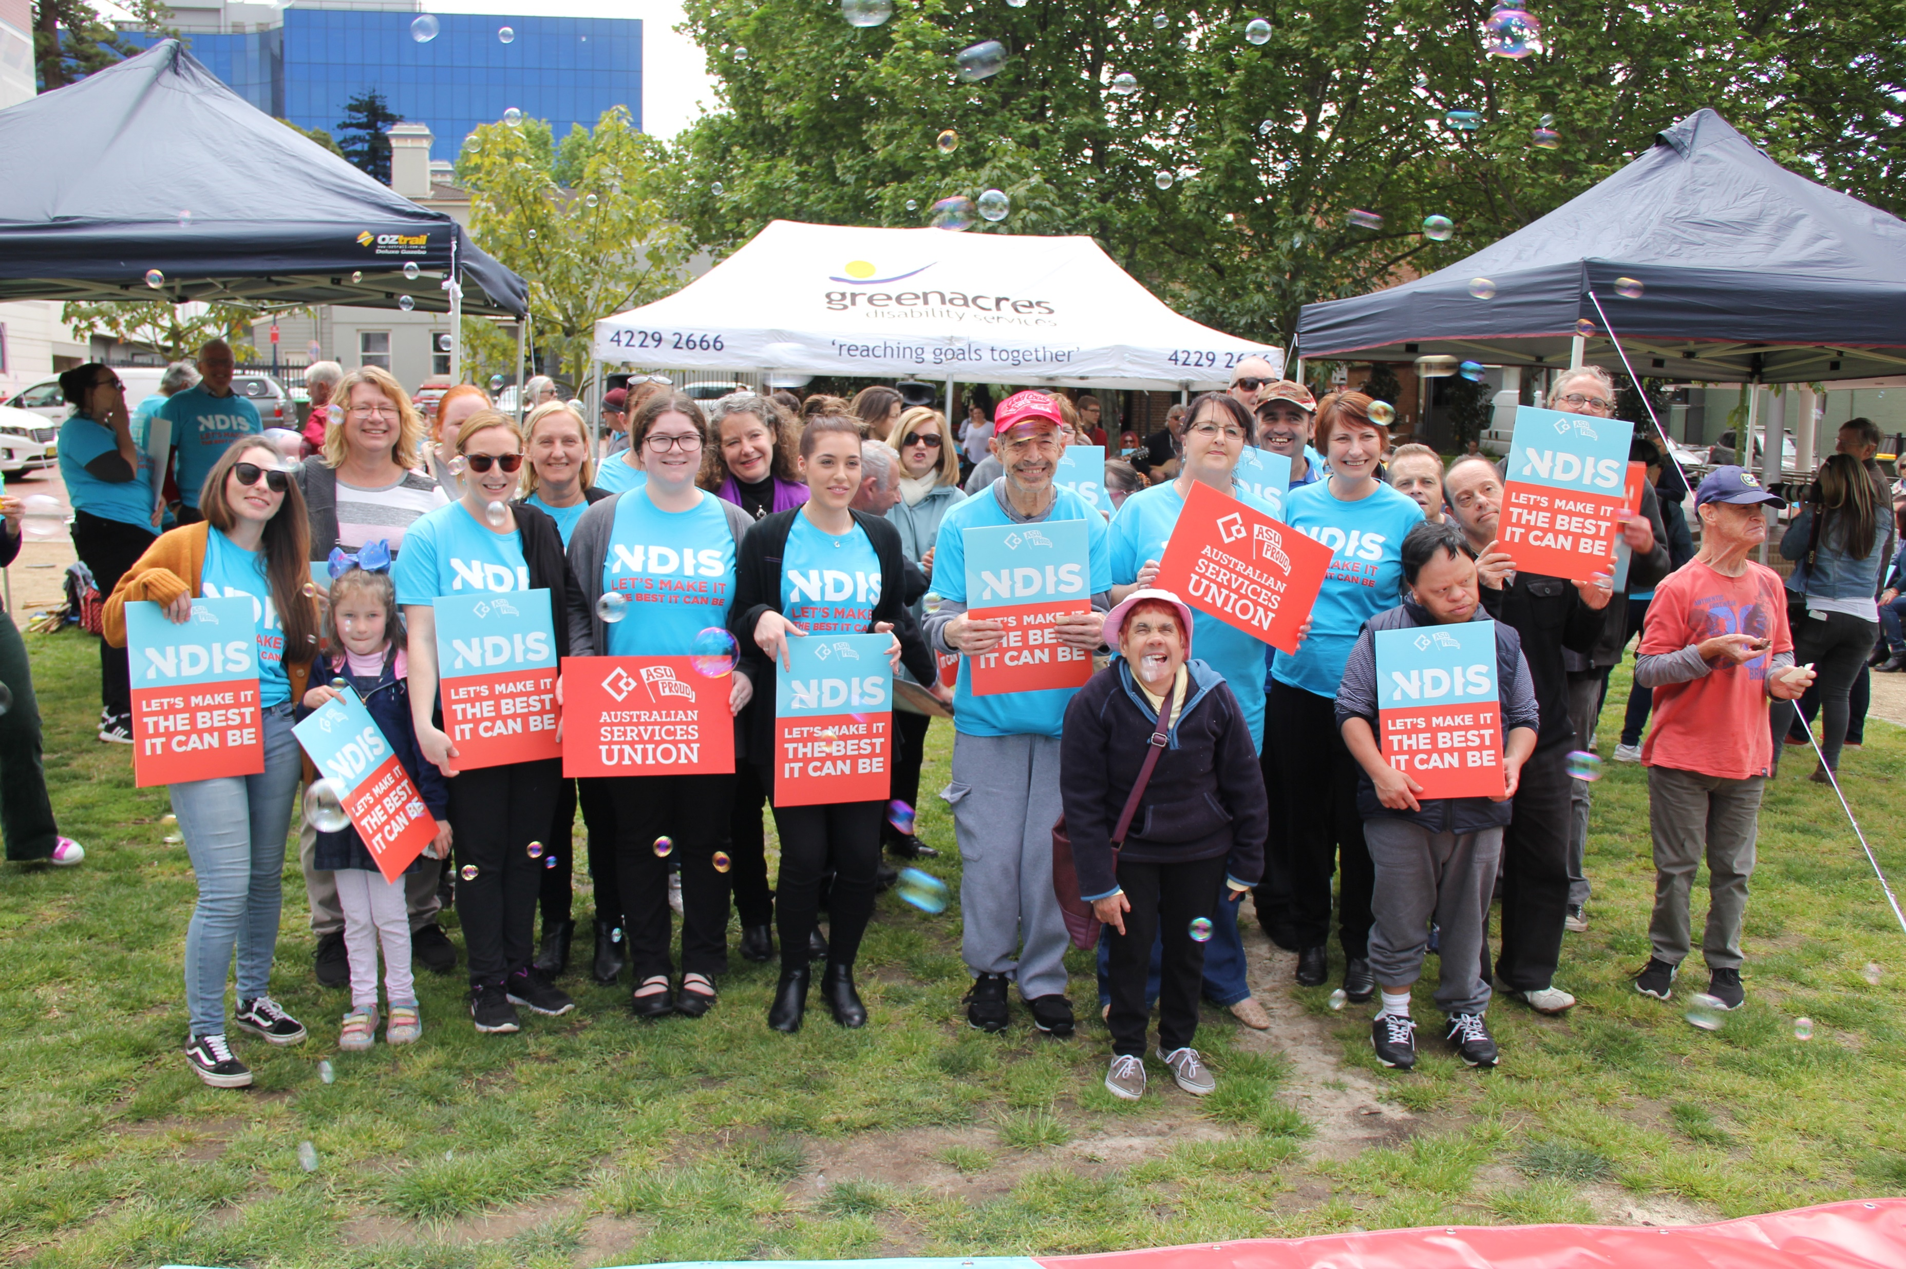
Wollongong Rally
Australian Services Union

Slide 18
NDIS rally in Ballina
Australian Services Union

Slide 19
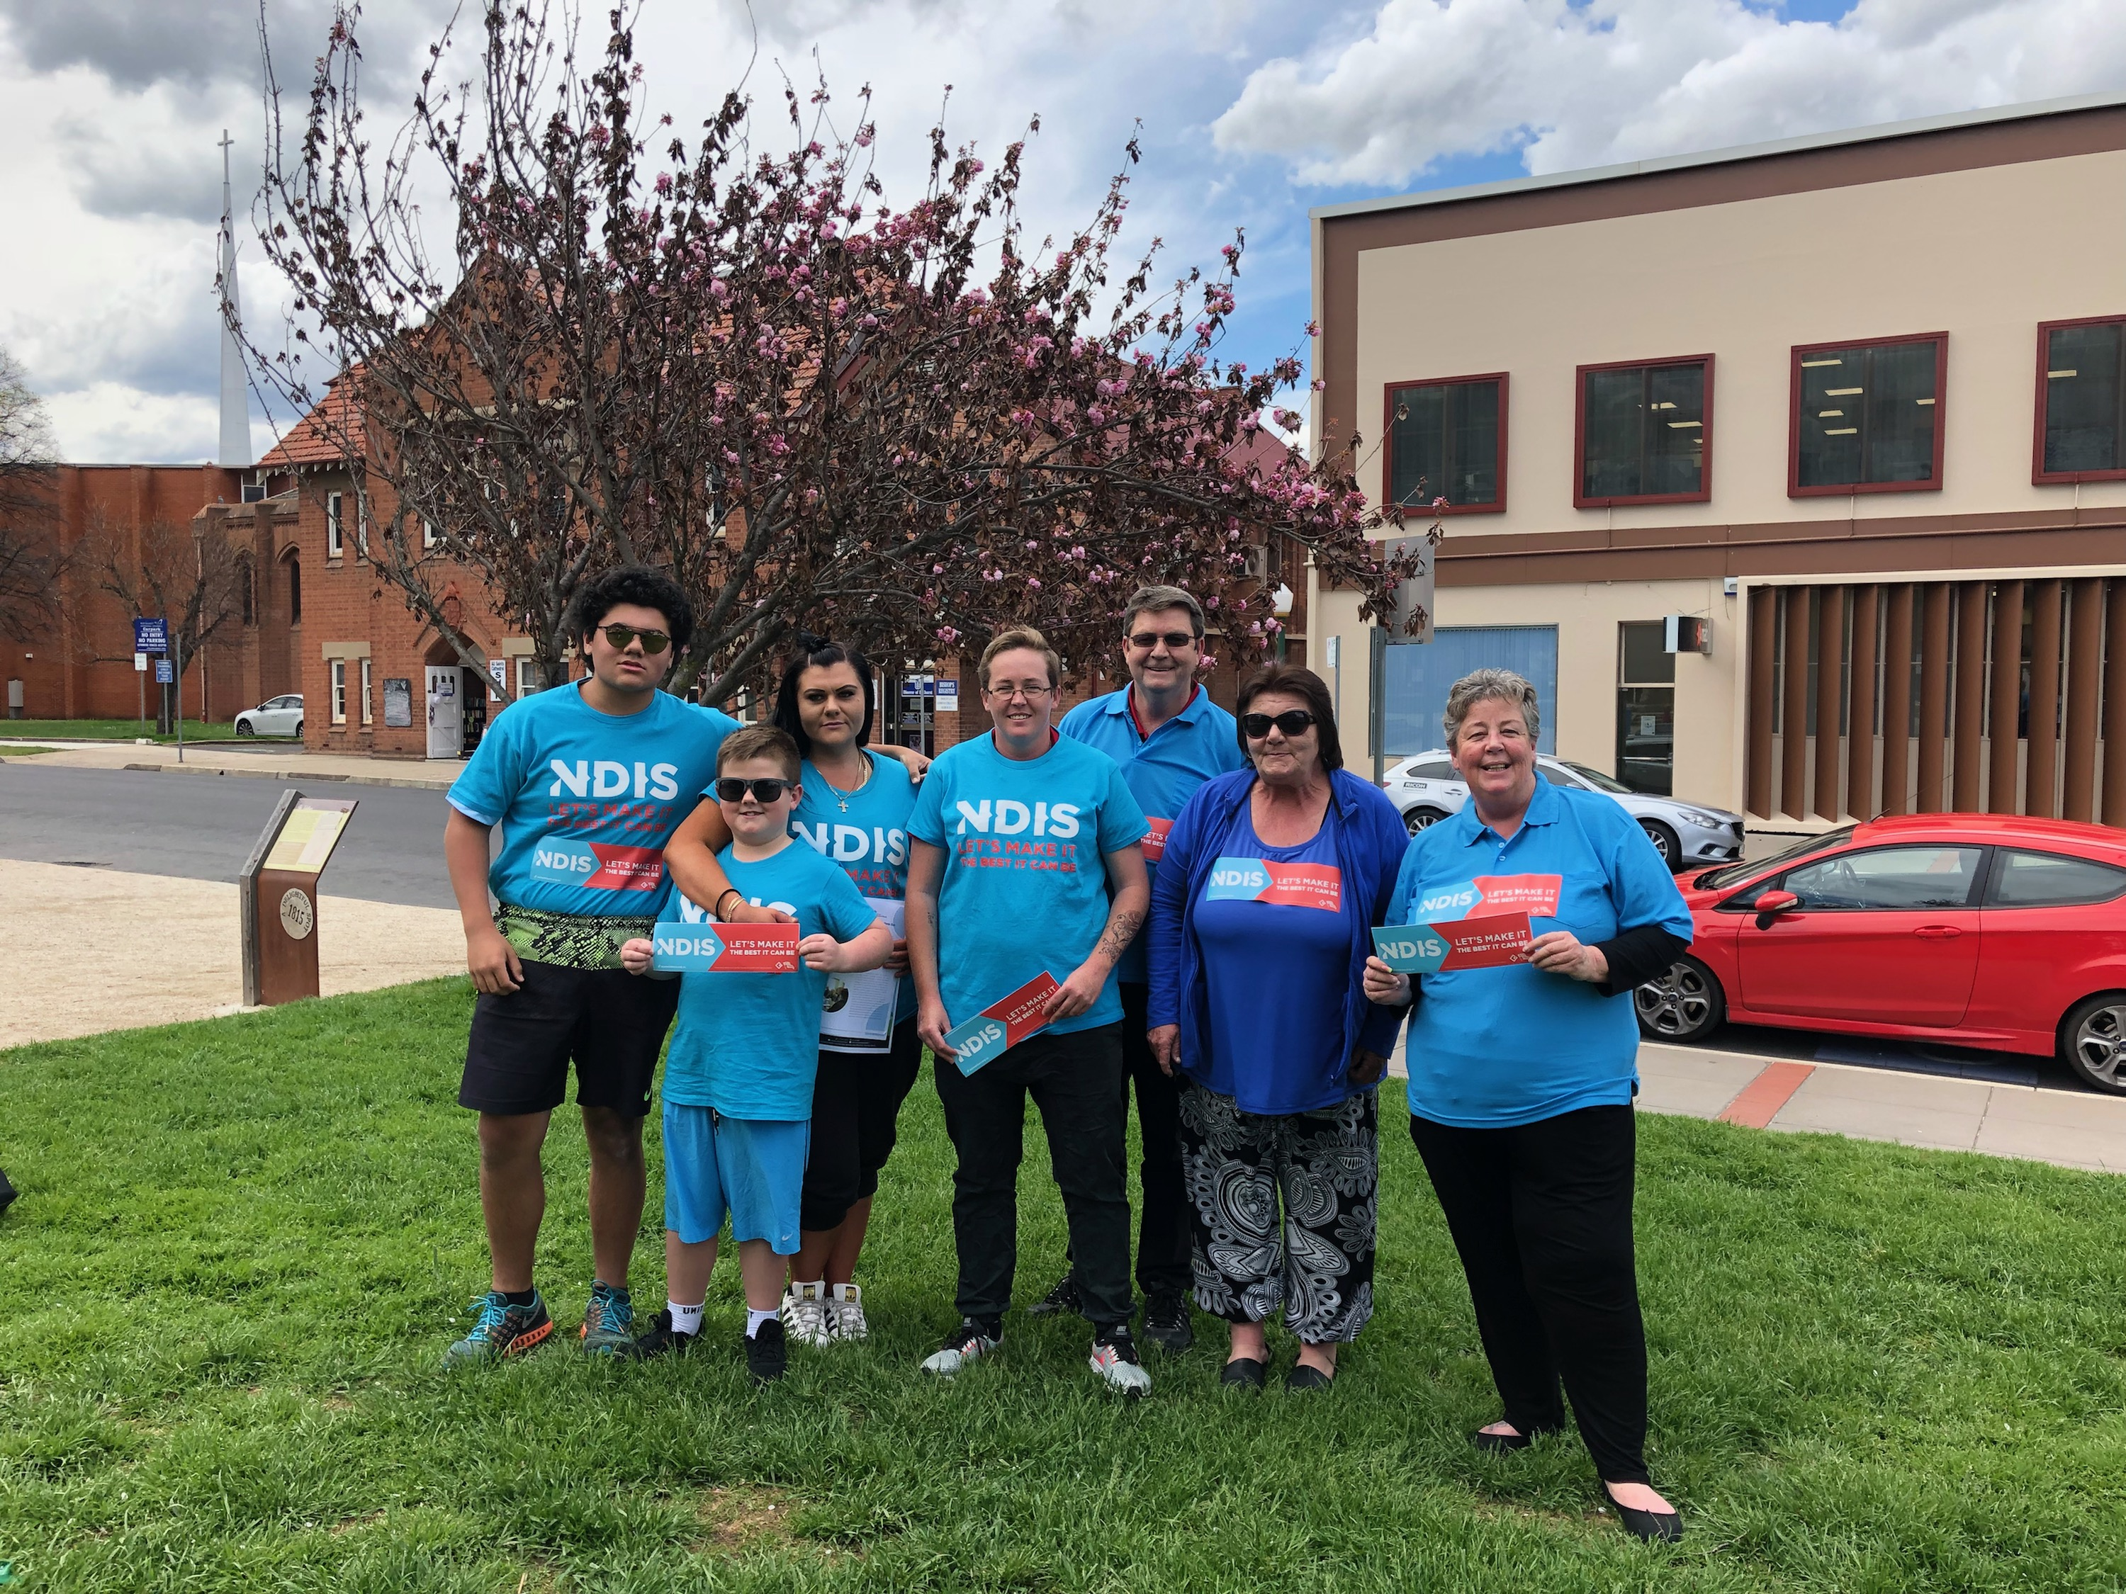
Our Broken Hill NDIS Rally!
Australian Services Union

Slide 20
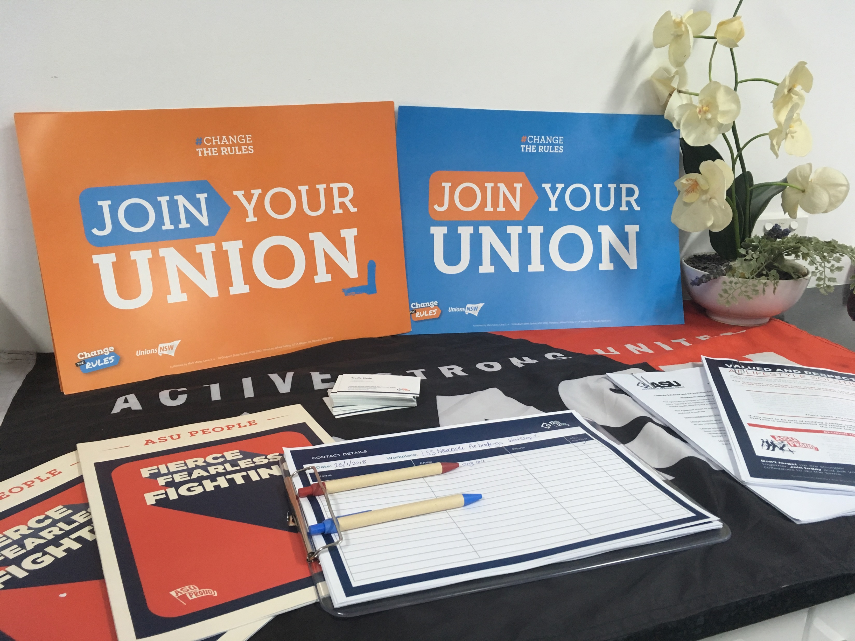
Learn to pack a portable campaign office
Australian Services Union

Slide 21
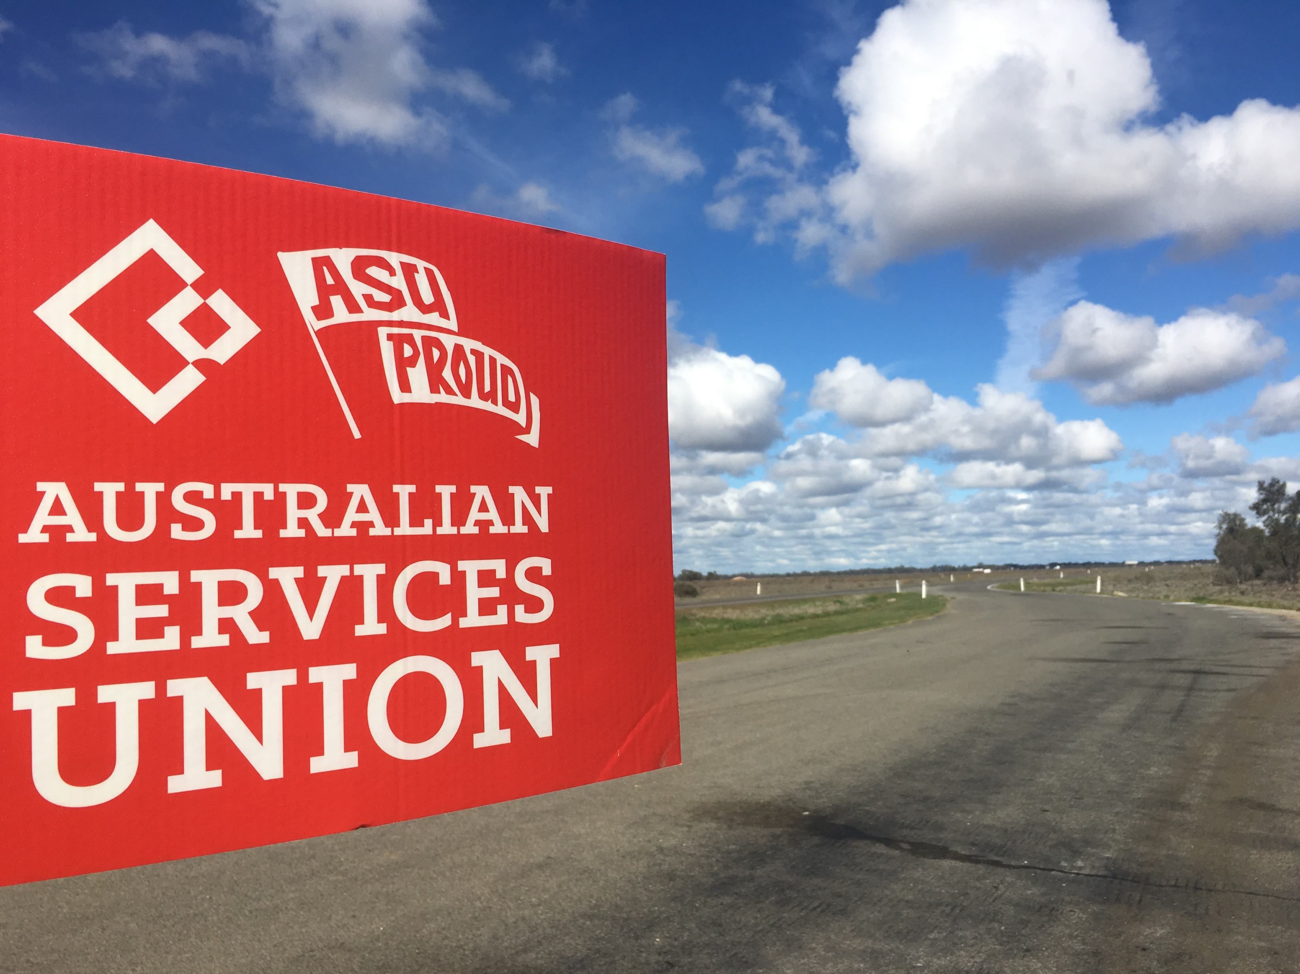
Regional Organising can be a tough long road.
They don’t call it the struggle for nothing!
Australian Services Union

