Slide 1
Trade agreements, jobs and regional communities
Dr Patricia Ranald, Convener Australian Fair Trade and Investment Network (AFTINET), Honorary Research Fellow , University of Sydney

Slide 2
Outline
Australia’s neoliberal trade policy suits global corporations, ignores regional needs
Different levels of trade agreements: global, regional, bilateral
Trade process secretive and undemocratic
Recent campaign on Indonesia, Hong Kong and Peru agreements
Regional Comprehensive Economic Partnership (RCEP) campaign
What changes are needed for fairer trade that can benefit regions?
Campaign actions

Slide 3
Australia’s neoliberal trade policy: not just free trade but more corporate rights
Global production chains suit the needs of global corporations
Each country should produce its lowest cost goods, with no active regional development, local employment or environment policies
Aims for zero tariffs and zero “other barriers”, priority for agriculture, services, mining exports, (not manufacturing)
Ignores workers’ rights and environment, race to the bottom
Other corporate agendas: rights for global corporations to sue governments, increased medicine monopolies, increased numbers of vulnerable temporary workers tied to one employer, services and e-commerce deregulation
Trade deals always have winners and losers, but no independent studies to show impact on regional jobs and other social impacts

Slide 4
Different levels of trade agreements
World Trade Organisation: 164 countries, majority developing countries, consensus multilateral agreements apply to all members, differential treatment for developing countries. Now stalled because developing countries resisting unfair proposals by industrialised countries.
Regional agreements: Trans-Pacific Partnership Agreement (TPP) 11 countries), proposed Regional Comprehensive Economic Partnership (RCEP) 16 countries, includes China, India, 10 ASEAN countries, half of world population
Bilateral: two countries: Australia has nine bilaterals with NZ, Singapore, US, Chile, Thailand, Malaysia, Japan, South Korea, China. Indonesia, Hong Kong, Peru signed but not yet ratified.

Slide 5
Australian Trade Agreement process one of most secretive and undemocratic
Trade agreements are negotiated in secret, but legally bind lower tariff levels and other rules
The text is secret and becomes public only after the decision to sign the agreement is made by Cabinet
Parliamentary Treaties committee review cannot change the text
No independent studies of economic, social or regional impacts
Parliament only votes on implementing legislation, not the whole agreement, before ratification
Designed to "lock in" future governments, reduce democratic space
Campaigns to influence content from start and/or block implementing legislation, also for more democratic and transparent process: other models exist

Slide 6
Legal enforceability of trade agreements
The main enforcement is though Government-to-government dispute processes : one government can lodge a dispute if another government breaks the rules
Disputes are heard by trade tribunals and the winner can ban or tax the products of the losing government
Also investor-state disputes (ISDS): a single foreign corporation can bypass national courts and claim compensation from the government at international investment tribunals for millions or even billions if they can claim that a change in law or policy “harms” their Investment or future profits: undermines democratic regulation
ISDS is controversial and not included in WTO agreements, and is not in all other agreements

Slide 7
Foreign investors can sue governments (ISDS)
Unfair international tribunals of investment lawyers
Even if governments win, they lose. The Philip Morris tobacco company lost its case against Australia’s plain packaging law, but it took 7 years for the decision and costs to be decided. It cost $24 million to defend, only $12 million recovered
The previous ALP Government had a policy against ISDS because of risks and costs to government. ALP policy still opposed, but so far have not blocked agreements with ISDS
The Howard Coalition government did not agree to ISDS in the 2004 US-Australia Free Trade Agreement, but the current Coalition government has supported it

Slide 8
Health, environment, land rights, privatisation and labour ISDS cases
2012 Philip Morris case against tobacco regulation, 2017 Eli Lilley case against Canada patent court decision
2017: US Bilcon Cement company won millions of dollars of compensation from Canada of because its quarry development was refused by a local government for environmental reasons, 2019 US Westmoreland mining company is suing Canada over Alberta’s decision to phase out coal-powered energy
2017: the Canadian Bear Creek mining company won $24 million from Peru because Peru cancelled a mining contract after the company failed obtain consent from Indigenous people about the mine
2016: Mexican transport company ADO threatened Portugal with a €42 million ISDS case after it cancelled plans to privatise part of Lisbon's public transport network
2012: French Veolia company sued Egypt over a rise in the minimum wage as part of a dispute over a local government contract

Slide 9
Labor trade policy December 2018 conference
Stronger policy, response to campaigning and backlash after majority in Labor caucus supported TPP-11 enabling legislation
No ISDS
No increase in medicine monopolies that delay access to cheaper medicines
No increase in vulnerable temporary workers without testing if local workers available
No restrictions on local content in government procurement, local industry development programs or reductions in anti-dumping rules
Enforceable labour rights, publication of text and independent evaluation of economic, social and regional impacts before signing
Labor to implement both in opposition and government

Slide 10
Indonesia, Hong Kong, Peru trade deals
Government bundled together enabling legislation for all three in October
Unions and AFTINET criticised provisions that are against Labor policy
All include ISDS, with some health exclusions, better process, but no exclusions for labour, environment, land rights, other public interest regulation
Cancelled old Peru and Hong Kong ISDS deals that have no exclusions
But old Indonesia ISDS deal not cancelled (mining industry influence)
Indonesia deal includes increased numbers of temporary workers
No enforceable labour rights, no independent evaluation of national or regional costs and benefits
Repression of human rights in Hong Kong

Slide 11
Labor endorsed Indonesia and other agreements after “assurances” from government
Will negotiate with Indonesia to cancel old Indonesia ISDS agreement
Evaluation of new ISDS provisions after 5 years
Claimed more effective regulation of temporary workers under existing laws
Unions and AFTINET criticised these assurances as weak and not likely to be delivered
Steel industry claims of increased exports not evaluated

Slide 12
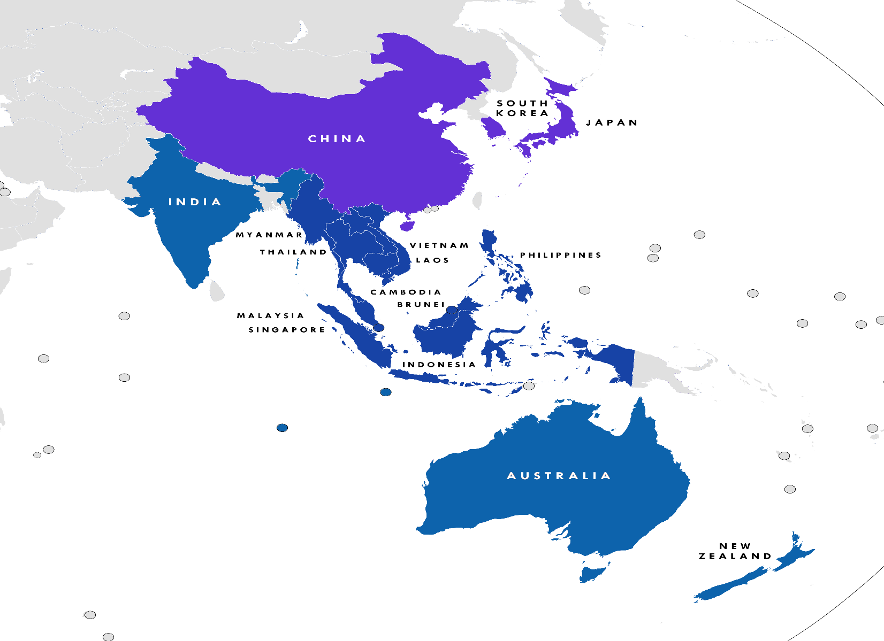
Regional Comprehensive Economic Partnership (RCEP): 16 countries, 3.5 billion people

Slide 13
Harmful proposals in RCEP
Negotiations began 2012: 28 rounds, aim to finish next week and sign in 2020
We know from leaked documents and some government statements:
Australia wants increased agriculture, services exports, mining investment
Japan, South Korea pushing stronger medicine monopolies, delaying access to cheaper medicines, worst impacts in low income countries, (India and others resisting, some proposals may be withdrawn)
Monopolies on seeds and plants: impacts on small farmers
Strong campaigns against ISDS, Malaysia says is now excluded
Services chapter freezes regulation, could prevent re-regulation of privatisation failures e.g. hospitals
E-commerce chapter favours big tech companies: Google, Facebook, Amazon
No chapters on labour rights, environmental standards
Latest reports still major differences: announcement November 4

Slide 14
RCEP campaign actions and key dates
International network of activists from RCEP countries campaigning since 2013
Lobbying, public actions at negotiations held in different countries
Joint statements and letters to governments, media coverage
Melbourne negotiations July 2019
Letter to Australian government from 52 community groups: media coverage
Presentations to negotiators from all countries for industry policies, against ISDS, medicine monopolies, other issues
Public meeting and rally
Parliamentary lobbying and Senate petitions August –November 2019
Meetings with MPs and Senators
Parliamentary Forum September 11
Petitions to the Senate; November
Possible signing 2020, Treaties committee inquiry and legislation.

Slide 15
Trade justice vision: trade should improve peoples’ lives
Trade agreements should support, not restrict, policy for a diverse, equitable, balanced, environmentally sustainable economy, with essential services for all
Open and democratic trade process, release negotiating text and final text before it is signed, parliament should vote on whole agreement
Independent studies of economic, social, regional impacts before signing
Trade agreements should be based on enforceable labour rights and environmental standards, not a race to the bottom
No increases in numbers of vulnerable temporary workers
No ISDS
No extension of medicine monopolies in trade agreements
No restrictions on regulation of education, health services or other public interest regulation

Slide 16
The Australian Fair Trade and Investment Network (AFTINET)
AFTINET is a network of 60 community organisations and many individuals advocating for fair trade based on human rights, labour rights and environmental sustainability
Current campaigns against bad proposals in the RCEP with similar groups in other countries
RCEP petition and leaflet
Join or donate at www.aftinet.org.au
Facebook www.facebook.com/aftinet?
twitter @AFTINET

